Slide 1
Year 9

Slide 2
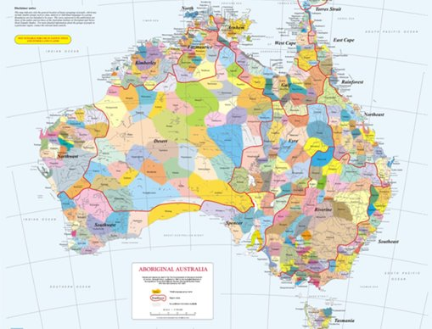
Acknowledgement
[Name of school/class] acknowledges Country, Custodians and Community of the lands on which we are on today [insert name of land/ peoples].
We also pay our respects to Elders and to Stolen Generations survivors, of the Dreaming and of the here and now.
We recognise the ongoing nature of trauma experiences for First Nations peoples and commit each day to survivor-led intergenerational healing.
Notes:
Update this slide with the name of your school/ class and the name of the land/s on which you're presenting the lesson on.
You may choose to make the wording of this acknowledgement more specific to your land/school/experiences. The acknowledgement isn't a script that we have to follow, you may even introduce the unit by working with students to write an acknowledgement for your class.
Image credit: https://ipaustralia.libguides.com/c.php?g=451400&p=3082380

Slide 3
Aboriginal and Torres Strait Islander students and teachers should be aware that these resources may contain the names, images, and voices of deceased persons.
Notes:
Important to remind students to speak up if they are feeling discomfort, and any safety and wellbeing measures your school has in place.

Slide 4
Care and safety
These lessons might include some content that is confronting or overwhelming
We all need to understand a full history of Australia, including the experiences of Stolen Generations survivors, their families and communities, and the impacts of past government policies that are still being felt today
It is important to speak to me or another adult if at any point you feel distressed – we are all here to learn together and keep each other safe.
Notes:
Important to remind students to speak up if they are feeling discomfort, and any safety and wellbeing measures your school has in place.
This is also a good place to ask the cultural safety questions from the educator's guide so you can co-construct a culturally safe space with your students.

Slide 5
Healing together
Why is learning about the Stolen Generations important?
to change the way we look at our collective history.
to support reconciliation and an honest understanding of our past – not just one perspective.
to become aware of past government policies that still affect many Aboriginal and Torres Strait Islander peoples and families today.
Notes:
Give students a chance to suggest why they think the learning is important before clicking through to the reasons.

Slide 6
Cultural Safety
How does a safe classroom look to you?
How does it feel?
How can we be culturally safe?
Notes:
You may have already established this as a class, if so, use this time to reiterate the class rules.
Begin a discussion about cultural safety with the class. Ask them to answer the questions in a 'think/pair/share' activity, or address them as a group.
Use the final question to lead in to the next slide.

Slide 7

Cultural Safety
Open mindedness
Respect
Honest communication
Being mindful of privilege
Notes:
A culturally safe classroom environment relies on open-mindedness, respect and honest communication.
Make any changes needed for this discussion to be age-appropriate for your class
Image credit: Sketchify from Canva

Slide 8
Overview: this week’s activities
ACTIVITY 1: RESPONSE TO DANCE WRITTEN REVIEW
Students view Bangarra Dance Theatre's Mathinna, investigating and evaluating the method of dance and performance to share stories. Students compile their responses and opinions in a written review.
ACTIVITY 2: CRITICAL ANALYSIS MIND MAP
Students critically analyse Sorry Day by Coral Vass and Dub Leffler. Students create a mind map and multi-modal presentation on the historical, social and cultural value of the book.
ACTIVITY 3: ARTWORK COMPARISON
Students compare two contemporary artworks, Tony Albert’s Sorry and Bindi Cole’s I Forgive You. Students use critical thinking and analytical skills to compare and contrast the artworks’ aesthetic, historical, social and cultural impacts.
ACTIVITY 4: POETRY WRITING AND PERFORMING
Students analyse poems from Us Taken-Away Kids and slam poetry performed by Steven Oliver. In pairs, students write and perform their own spoken word poems reflecting on their learning about the Stolen Generations.
Notes:
OPTIONAL SLIDE
Update week to timeframe for these teaching activities in consideration of class schedule and activity time.

Slide 9
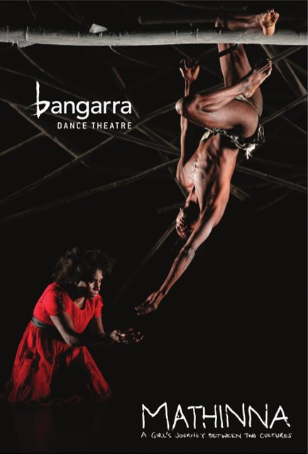

Activity 1: Written Response to Dance
Notes:
Students view Bangarra Dance Theatre's Mathinna, investigating and evaluating the method of dance and performance to share stories. Students compile their responses and opinions in a written review.
Image credit: https://statements.qld.gov.au/statements/93514
Resources
Telling the Story: Mathinna (2008).
Mathinna Bangarra Dance Theatre Education Resource.
Excerpts from Mathinna.
Mathinna – Study Guide.
Worksheets and stimulus questions (Worksheets 1, 2 and 3).

Slide 10
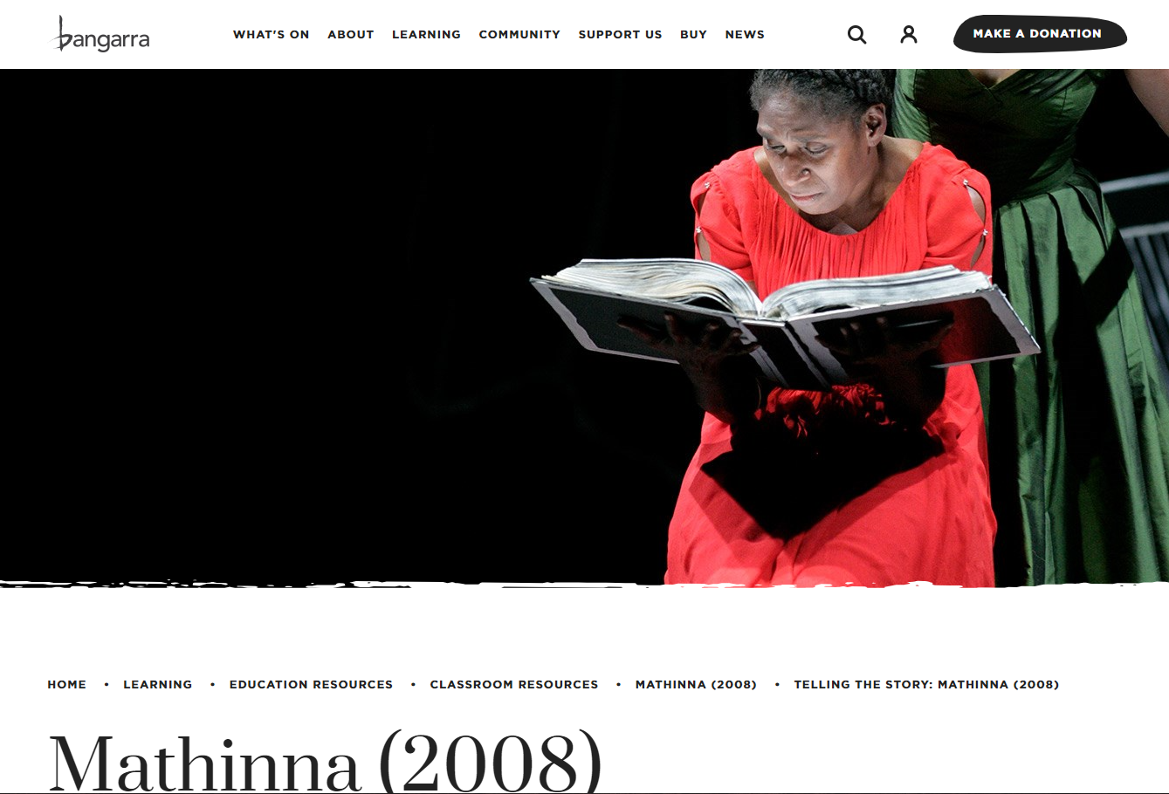
Bangarra Dance Theatre – Company Profile
Notes:
About Bangarra:
Bangarra is an Aboriginal & Torres Strait Islander organisation and one of Australia’s leading performing arts companies. Their dance technique is forged from over 40,000 years of culture, infused with contemporary movement. The company’s dancers are professionally trained, dynamic artists who represent the pinnacle of Australian dance. The company's relationships with Indigenous communities are the heart of Bangarra, with their repertoire created on country and stories gathered from respected community Elders.
Display the website Telling the Story: Mathinna and read through the story with students: https://www.bangarra.com.au/learning/education-resources/classroom-resources/mathinna-2008/telling-the-story-mathinna-2008/
Info above from: https://www.youtube.com/@bangarradancetheatre/about

Slide 11

Written response to dance
Who is a contemporary First Nations artist that you know?
Do you believe dance and theatre is a form of story telling? Why/Why not?
How does Mathinna’ story fit in to your understanding of the Stolen Generations?
Complete the "before viewing" worksheet
Notes:
Facilitate whole class discussion before handing out Worksheet 1

Slide 12
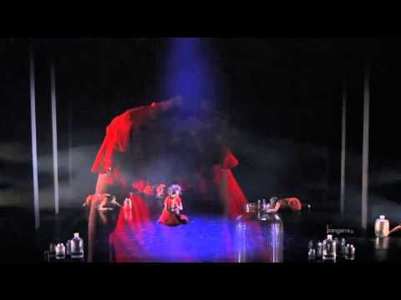
Video: MATHINNA Bangarra Dance Theatre Education Resource
Notes:
Video Link: https://www.youtube.com/watch?v=wgEw4cgcE7o

Slide 13
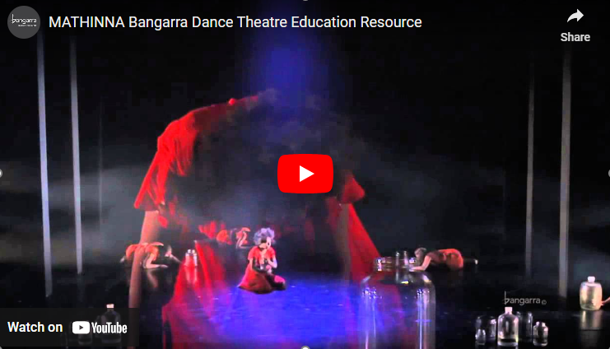
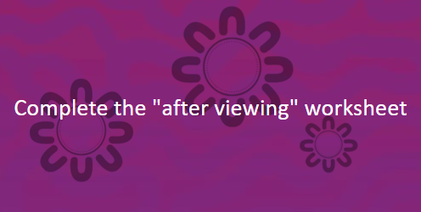
Video: MATHINNA Bangarra Dance Theatre Education Resource
Notes:
Distribute worksheet 2 and give students time to complete this worksheet

Slide 14
Written response to dance
Worksheet responses
What do you think of dance theatre as a method of storytelling?
What impact does this form of theatre have?
Time to review!
Notes:
Facilitate whole class discussion of the points above

Slide 15
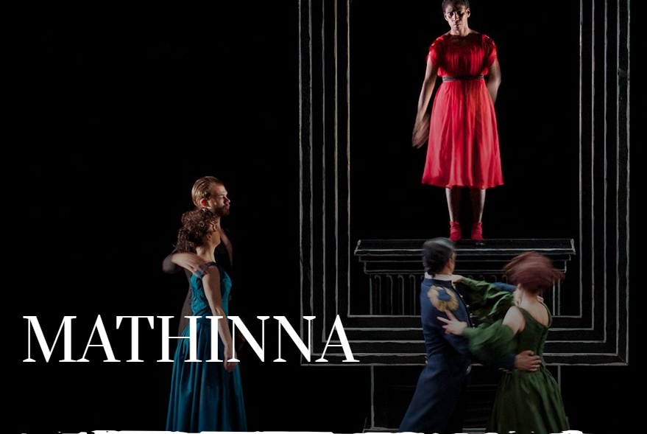
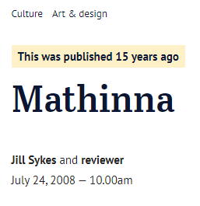
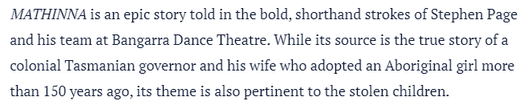
Written response to dance
You will be planning and drafting a written review in response to Mathinna as a production of contemporary storytelling. To help you write, you can use:
Completed worksheets (1 and 2)
Worksheet 3
Include images and quotes (from dancers, directors or Mathinna's letter) to support your writing
Notes:
Distribute worksheet 3.
You may wish to read through the example review as a class: https://www.smh.com.au/entertainment/art-and-design/mathinna-20080724-gdslm6.html
When students have finished writing, you may get them to swap with a peer for editing and providing feedback.
Image from: https://www.bangarra.com.au/productions/mathinna/

Slide 16

Reflect on your learning
Notes:
Take some time for students to share reflections on the lesson

Slide 17

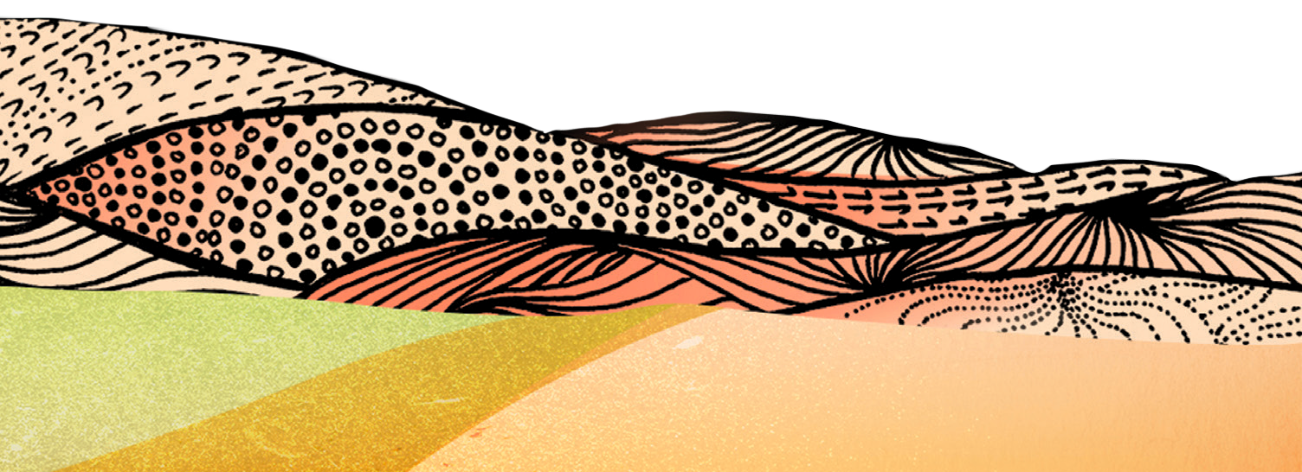

Activity 2:
Critical analysis mind map
Notes:
Students critically analyse Sorry Day by Coral Vass and Dub Leffler. Students create a mind map and multi-modal presentation on the historical, social and cultural value of the book.
Resources
For your own background knowledge, read Sorry Day teachers’ notes.
Book: Sorry Day by Coral Vass and Dub Leffler.
Video: Sorry Day by Coral Vass and Dub Leffler.

Slide 18
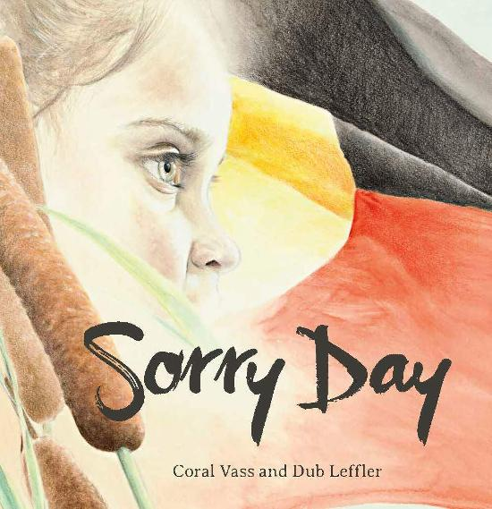
Sorry Day by Carol Vass and Dub Leffler
Discuss the following:
What is the significance of the cultural backgrounds of the author and illustrator?
The tandem storyline
Characters in the book
Language of the book
Aesthetic features of the book
The historical, social and cultural value of this book
Notes:
Either read through Sorry Day or watch the video: https://www.youtube.com/watch?v=R8RDYXe8ntQ
After reading the book, work through the discussion points.

Slide 19
Mind Map
Form groups of 2-3
Create a mind map on the historical, social and cultural value of the book. Mind maps should include:
quotes and images from the book
quotes from the author and/or illustrator
quotes and/or images from the National Apology
statistics and information about the Stolen Generations
a clear expression of the student’s opinion of the historical, social and cultural value of the book.
Notes:
Ensure students have equipment needed to complete mind map. If needed, demonstrate how to construct on the board as students discuss in their groups

Slide 20
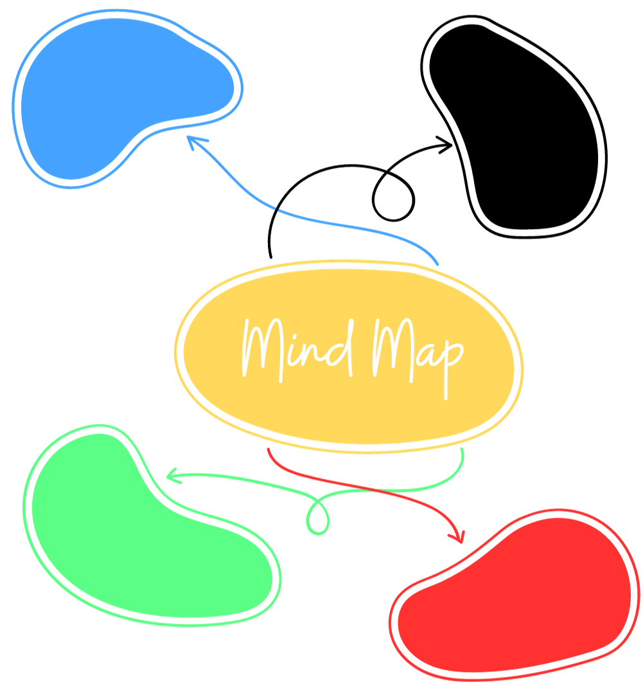
Multi-modal Presentation
Use your mind map to create​ a multi-modal presentation
Recommended platforms include:​
PowerPoint, Keynote, Canva, Prezi, video, whiteboard presentation.
Deliver your presentation!
Consider sharing your presentation with The Healing Foundation so Stolen Generations survivors can see your work
Notes:
Ensure students have all equipment required for this task. If time limited, have students present mind maps rather than creating the presentation.

Slide 21
Activity 3:
Artwork Comparison
Notes:
Students compare two contemporary artworks, Tony Albert’s Sorry and Bindi Cole’s I Forgive You. Students use critical thinking and analytical skills to compare and contrast the artworks’ aesthetic, historical, social and cultural impacts.
For your own background knowledge read
Tony Albert – Visible – Teacher Notes.
Sorry (2008) by Tony Albert – artwork overview.
I Forgive You (2012) – Bindi Cole.
Bindi Cole – Contemporary Australia: Women – GOMA.
Tony Albert discusses Sorry, created for the National Apology in 2008.

Slide 22
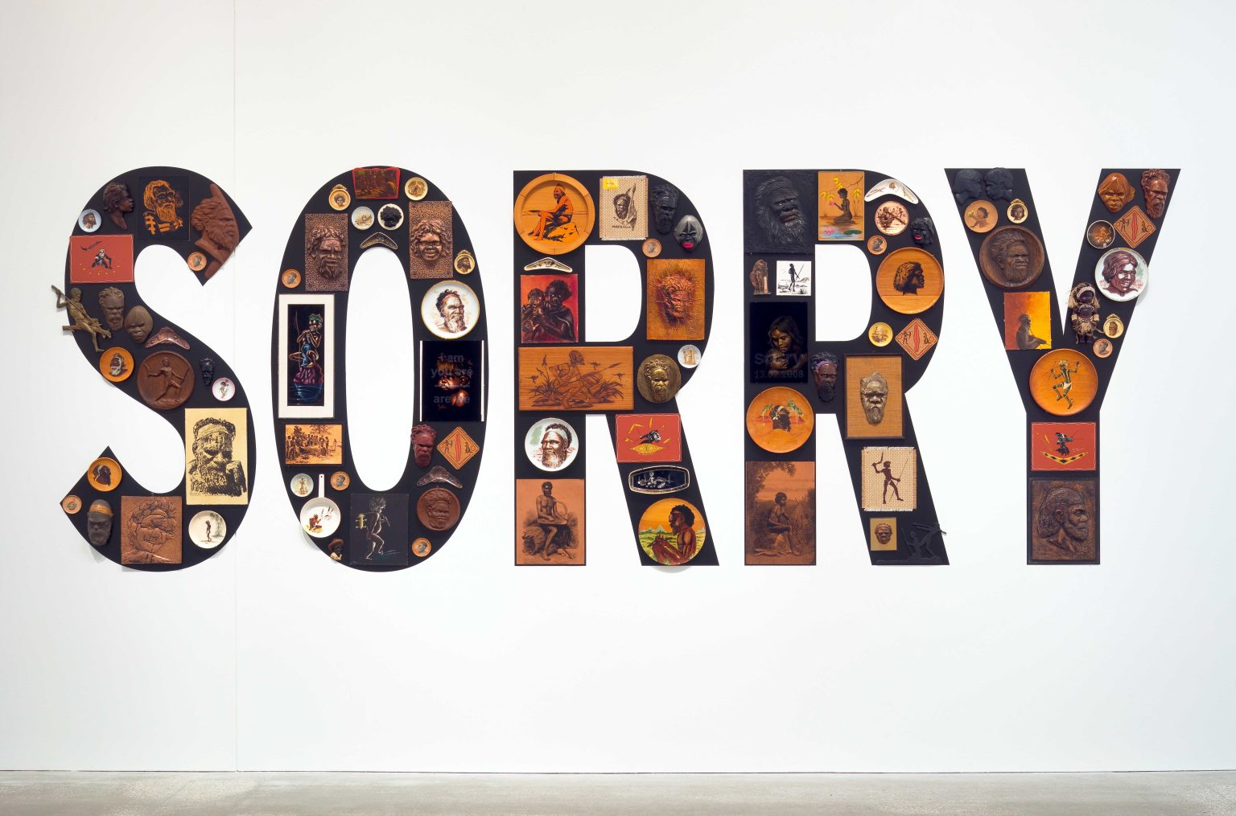
Artwork comparison
Artist: Tony Albert / Girramay, Yidinyji and Kuku Yalanji peoples / Artwork: 'Sorry' 2008
Notes:
Give students time to view the artwork
Link to Artwork: https://blog.qagoma.qld.gov.au/tony-albert-sorry-is-just-a-word-if-it-is-not-backed-up-by-real-outcomes-australia/

Slide 23
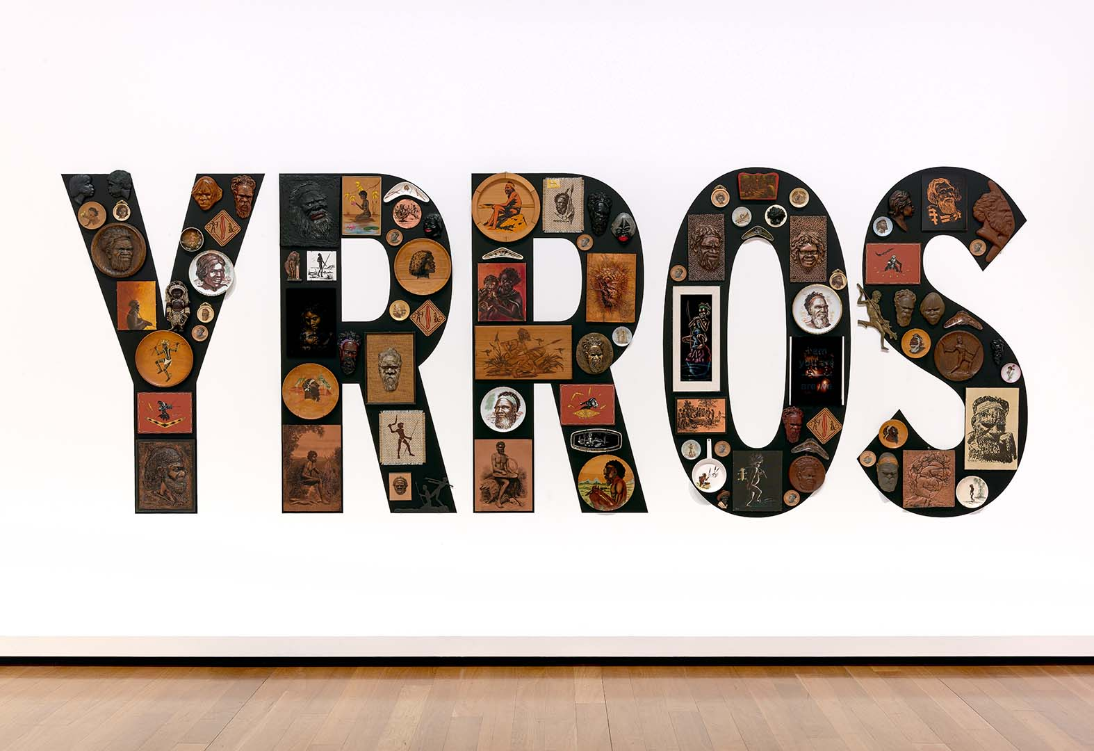
Artwork comparison
Inverse Installation
Artist: Tony Albert / Girramay, Yidinyji and Kuku Yalanji peoples / Artwork: 'Sorry' 2008
Notes:
Give students time to view the artwork
Link to Inverse installation: https://learning.qagoma.qld.gov.au/artworks/sorry/

Slide 24
Artwork comparison
What media and materials were used to make the artwork?
What assumptions did you make about the historical, social and cultural context of the artwork?
Artist: Tony Albert / Girramay, Yidinyji and Kuku Yalanji peoples / Artwork: 'Sorry' 2008
Notes:
Link to Artwork: https://cdn.sanity.io/files/m2obzhc2/production/c408d0e76bee72e31629fb0b2dff8892c186b7cd.pdf

Slide 25
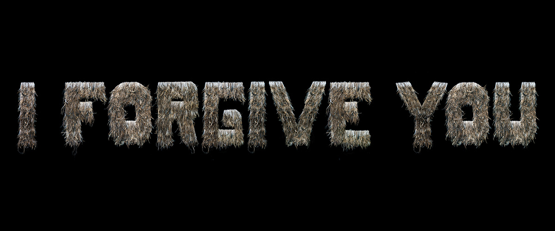
Artwork comparison
Artist: Bindi Cole/ Artwork: 'I forgive you' 2012
Notes:
Facilitate whole class discussion about the artwork, including:
The media and materials used to make the artwork.
Students’ first impressions of the historical, social and cultural context of the artwork.
Link to Artwork: https://learning.qagoma.qld.gov.au/artworks/i-forgive-you/

Slide 26

Video: Tony Albert discusses 'Sorry' created for the National Apology in 2008
Notes:
Link to video: https://www.youtube.com/watch?v=htlM8m6j6i8

Slide 27
Artwork comparison
What is the significance of Tony Albert's cultural background?
What is the political context of the artwork?
Why is that significant?
Share your reflections on the artwork’s first iteration as ‘SORRY’ and second iteration as ‘YRROS’, and how the artwork has changed over time
Artist: Tony Albert / Girramay, Yidinyji and Kuku Yalanji peoples / Artwork: 'Sorry' 2008
Notes:
Facilitate a whole class discussion to address the questions in the slide
Link to video: https://www.youtube.com/watch?v=htlM8m6j6i8

Slide 28
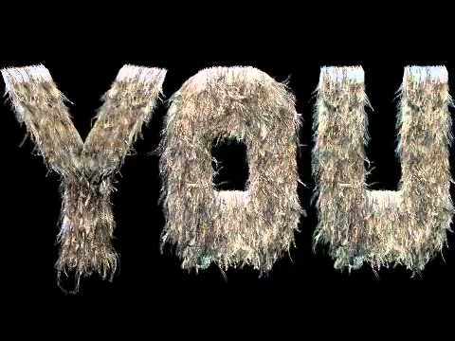
Video: Bindi Cole | Contemporary Australia: Women | GOMA
Notes:
Link to video: https://www.youtube.com/watch?v=ggM93NRxZ30

Slide 29
Artwork comparison
What is the significance of Bindi Cole's cultural background?
What is the political context of the artwork?
Why is that significant?
Reflect on the artist's idea of forgiveness being empowering and freeing to both parties
Artist: Bindi Cole/ Artwork: 'I forgive you' 2012
Notes:
Facilitate a whole class discussion to address the questions in the slide
Link to video: https://www.youtube.com/watch?v=ggM93NRxZ30

Slide 30
Written response
Students write an analytical research essay, newspaper article, or other written work comparing the two artworks.
Essays should include:
Research gathered from credible sources such as QAG/GOMA, ABC, Eyeline, ArtGuide etc.
Descriptions of the artworks, media and materials
Quotes from the artists speaking about their artistic practice
Evaluation of how the artwork functions as a visual text to represent the artist’s perspective
Analysis of the artworks’ historical, social, cultural and political value
Images of the artworks.
Notes:
Guide students through their text creation. You may want to make the text specific to the learning of your class.

Slide 31
Reflection
Notes:
Discuss with students where they may be able to publish their texts and reflect on the experience of creating the text

Slide 32
Activity 4:
Poetry Writing and Performing
Notes:
Students analyse poems from Us Taken-Away Kids and slam poetry performed by Steven Oliver. In pairs, students write and perform their own spoken word poems reflecting on their learning about the Stolen Generations.
Resources
Us Taken Away Kids – Human Rights and Equal Opportunity Commission.
Video: Steven Oliver – Australian Poetry Slam 2014.
Video: Steven Oliver – Hate He Said.
Video: Steven Oliver – Real [0:35-4:35].

Slide 33
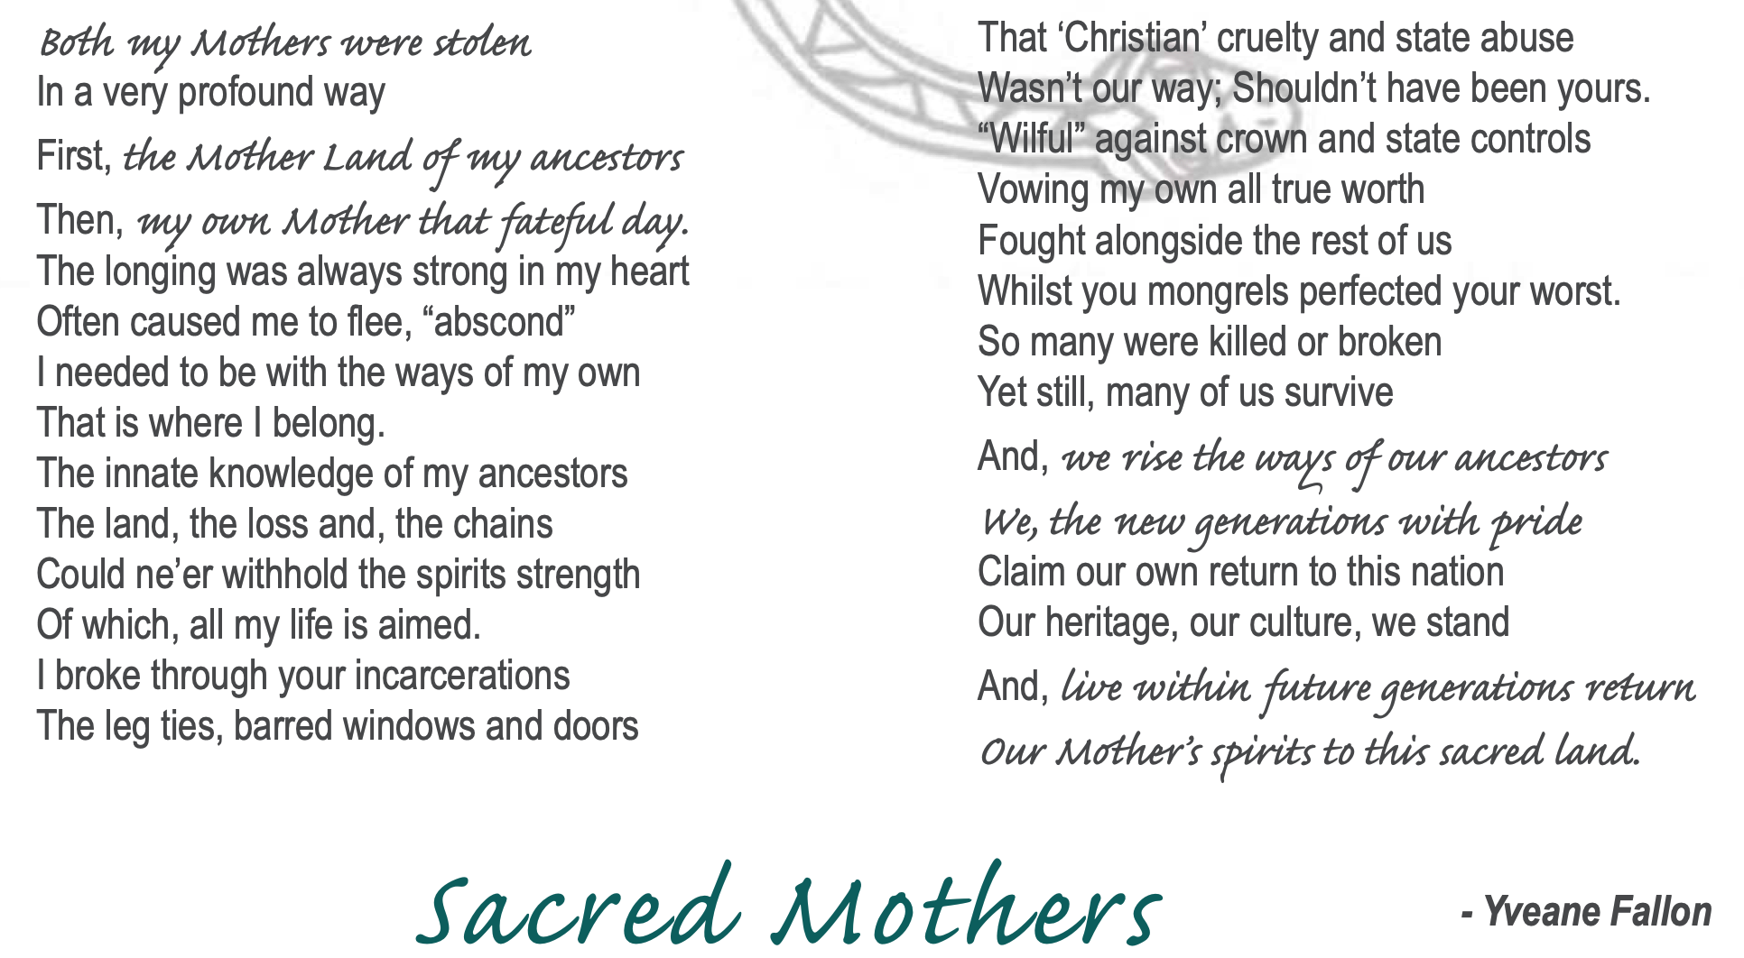
Poetry writing and performing
Notes:
Read the poem on the slide to the class, or select a student to read.
Facilitate whole class discussion and whiteboard notes to analyse the poem. Students use prior knowledge of:
Poetry genre and associated language conventions.
Personal accounts from Stolen Generations survivors.
Link to document (refer to Page 39): https://humanrights.gov.au/sites/default/files/content/bth/taken/us_taken_away2007.pdf

Slide 34
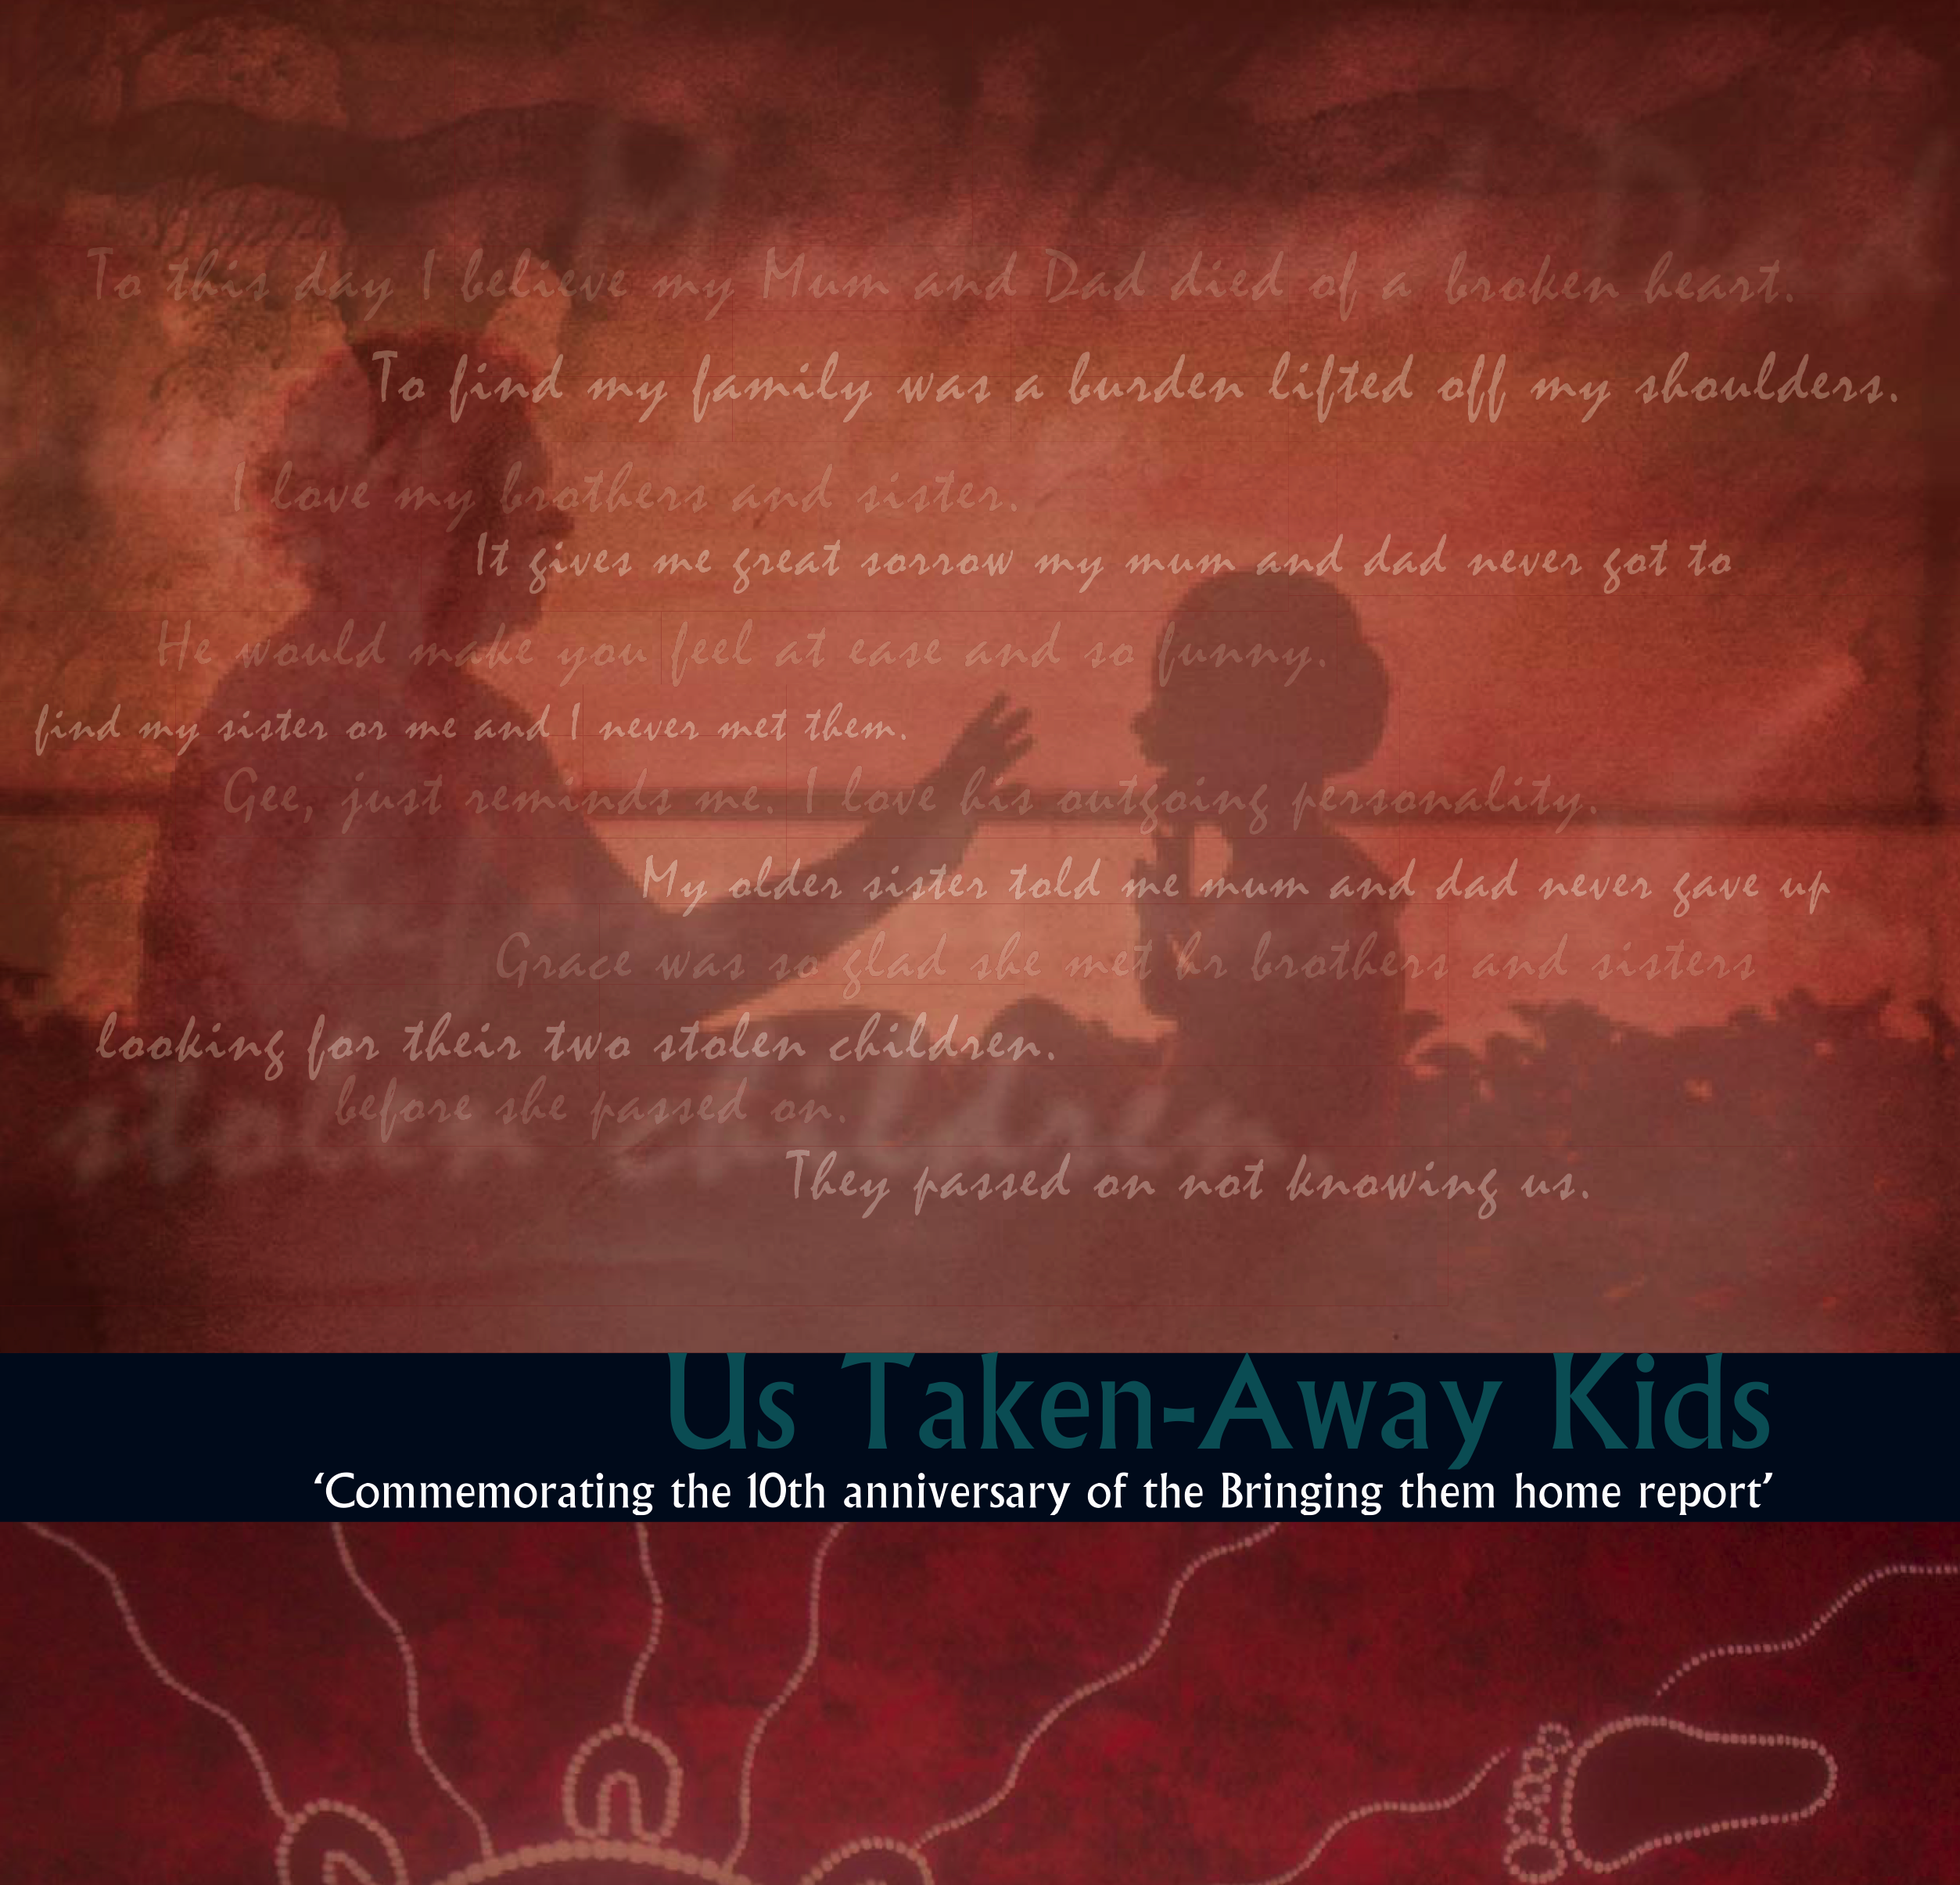
Poetry writing and performing
Form pairs
Select a poem from Us Taken Away Kids
Analyse this poem using your knowledge of poetry and the Stolen Generations
Notes:
Link to document: https://humanrights.gov.au/sites/default/files/content/bth/taken/us_taken_away2007.pdf

Slide 35
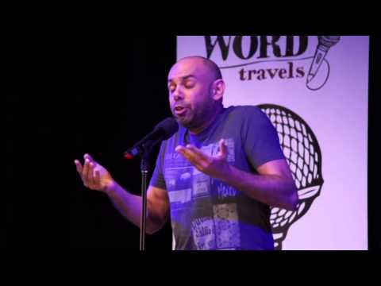
Video: Steven Oliver - Australian Poetry Slam Finalist 2014 - Steven Oliver
Notes:
Video link: Steven Oliver – Australian Poetry Slam 2014 https://www.youtube.com/watch?v=lyCp_rnbXDs

Slide 36
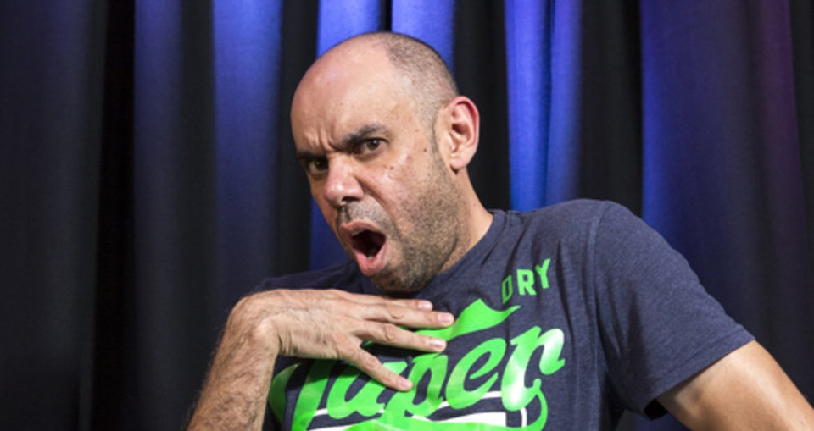
Video: Steven Oliver - Australian Poetry Slam Finalist 2014 - Steven Oliver
Thinking about the last video...
What is the historical, social, cultural and political context?
What is the cultural background and identity of Steven Oliver?
How did Steven's performance alter and enhance the impact of his poetry?
Notes:
You may prefer to run these discussions as a think/pair/share
Image link: https://theclothesline.com.au/steven-oliver-bigger-and-blacker-adelaide-cabaret-festival-2019-review
Video link: Steven Oliver – Australian Poetry Slam 2014 https://www.youtube.com/watch?v=lyCp_rnbXDs

Slide 37
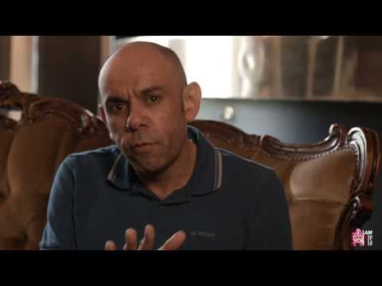
Video: "Hate He Said" by Steven Oliver
Notes:
Video links: Steven Oliver – Hate He Said https://www.youtube.com/watch?v=xurO_YulJ4c

Slide 38
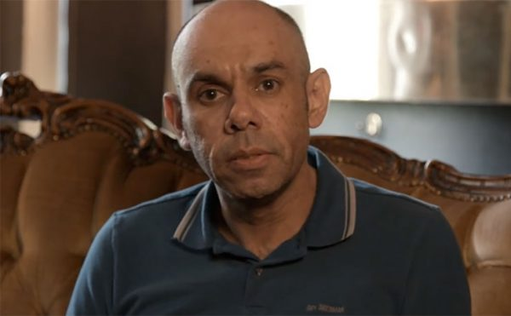
Video: "Hate He Said" by Steven Oliver
Thinking about the last video...
What is the historical, social, cultural and political context?
What is the cultural background and identity of Steven Oliver?
How did Steven's performance alter and enhance the impact of his poetry?
Notes:
You may prefer to run these discussions as a think/pair/share
Image link: https://newmatilda.com/2017/07/18/steven-olivers-poem-real-tops-2-million-views-lets-get-hate-he-said-there-as-well/
Video link: Steven Oliver – Australian Poetry Slam 2014 https://www.youtube.com/watch?v=lyCp_rnbXDs

Slide 39
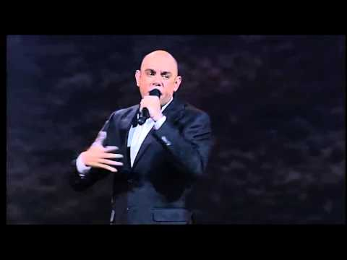
Video: Steven Oliver NAIDOC Awards 2015 NITV
Notes:
Video links: Steven Oliver – Real [0:35-4:35] https://www.youtube.com/watch?v=GW3dks0Eu5Q&t=43s

Slide 40
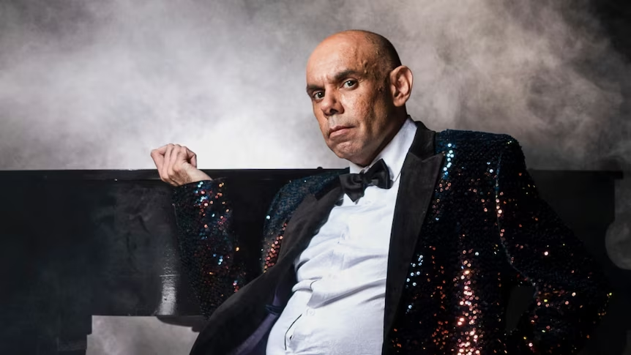
Video: Steven Oliver NAIDOC Awards 2015 NITV
Thinking about the last video...
What is the historical, social, cultural and political context?
What is the cultural background and identity of Steven Oliver?
How did Steven's performance alter and enhance the impact of his poetry?
Notes:
You may prefer to run these discussions as a think/pair/share
Image link: https://www.abc.net.au/qanda/steven-oliver-2022/101707356
Video link: Steven Oliver – Australian Poetry Slam 2014 https://www.youtube.com/watch?v=lyCp_rnbXDs

Slide 41
Poetry and performing
In pairs write your own poem to be performed as a spoken word piece:
You are to write only from your own perspective
You must express your opinion on the Stolen Generations and National Apology in a culturally safe manner
You must incorporate performative techniques such as
Persuasive language
Imagery
Gesture
Body language
Tone
Pace
Pitch

Slide 42
Poetry Performance
Notes:
Students should be encouraged to present their poems to the class

Slide 43
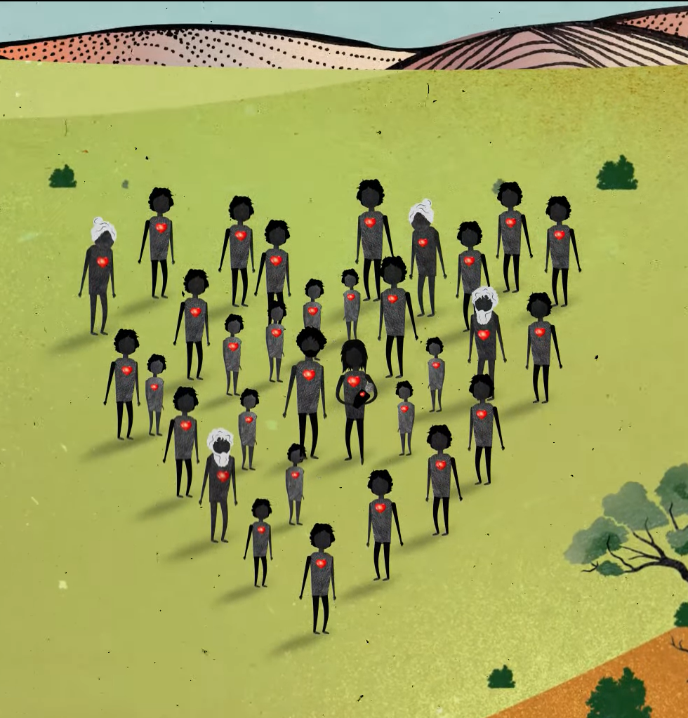

Contact The Healing Foundation
@HealingFoundation
@healingourway
@healingourway
www.healingfoundation.org.au
Healing Foundation
Notes:
Consider:
Sharing your outcomes and experience with The Healing Foundation at resources@healingfoundation.org.au
Sharing the resource and how you used it amongst your networks.
Sharing your students’ learning journey and tag The Healing Foundation on Instagram @healingourway and on Facebook as ‘Healing Foundation’.

