Slide 1
Year 7

Slide 2
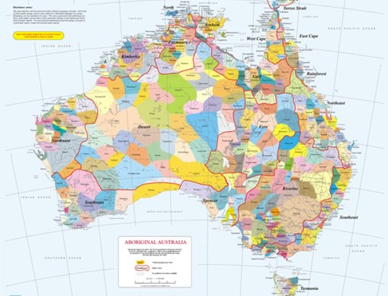
Acknowledgement
[Name of school/class] acknowledges Country, Custodians and Community of the lands on which we are on today [insert name of land/ peoples].
We also pay our respects to Elders and to Stolen Generations survivors, of the Dreaming and of the here and now.
We recognise the ongoing nature of trauma experiences for First Nations peoples and commit each day to survivor-led intergenerational healing.
Notes:
Update this slide with the name of your school/ class and the name of the land/s on which you're presenting the lesson on.
You may choose to make the wording of this acknowledgement more specific to your land/school/experiences. The acknowledgement isn't a script that we have to follow, you may even introduce the unit by working with students to write an acknowledgement for your class.
Image credit: https://ipaustralia.libguides.com/c.php?g=451400&p=3082380

Slide 3
Aboriginal and Torres Strait Islander students and teachers should be aware that these resources may contain the names, images, and voices of deceased persons.
Notes:
Important to remind students to speak up if they are feeling discomfort, and any safety and wellbeing measures your school has in place.

Slide 4
Care and safety
These lessons might include some content that is confronting or overwhelming
We all need to understand a full history of Australia, including the experiences of Stolen Generations survivors, their families and communities, and the impacts of past government policies that are still being felt today
It is important to speak to me or another adult if at any point you feel distressed – we are all here to learn together and keep each other safe.
Notes:
Important to remind students to speak up if they are feeling discomfort, and any safety and wellbeing measures your school has in place.
This is also a good place to ask the cultural safety questions from the educator's guide so you can co-construct a culturally safe space with your students.

Slide 5
Healing together
Why is learning about the Stolen Generations important?
to change the way we look at our collective history.
to support reconciliation and an honest understanding of our past – not just one perspective.
to become aware of past government policies that still affect many Aboriginal and Torres Strait Islander peoples and families today.
Notes:
Give students a chance to suggest why they think the learning is important before clicking through to the reasons.

Slide 6
Overview: this week’s activities
ACTIVITY 1: INTERVIEW AND PICTURE BOOK ANALYSIS
We are going to watch interviews with Stolen Generations survivors and write responses to them. We will also be analysing two picture books with contrasting perspectives on Australian history, society and culture.
ACTIVITY 2: DIARY ENTRY WRITING
We'll be writing a diary entry from the perspective of a child whose friend was removed, using the knowledge and understanding we gained in activity 1.
ACTIVITY 3: RESPONSE TO THE STORY OF THE HEALING FOUNDATION
Working in pairs, you are going to produce an advertisement for The Story of The Healing Foundation video.
ACTIVITY 4: LETTER TO THE MINISTER FOR EDUCATION
Using everything we've learnt, we will be writing persuasive letters to the Minister for Education, calling for The Healing Foundation's Stolen Generations Resource Kit for Teachers and Students to be compulsory in all schools.
Notes:
OPTIONAL SLIDE
Update week to timeframe for these teaching activities in consideration of class schedule and activity time.

Slide 7
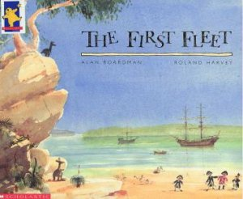
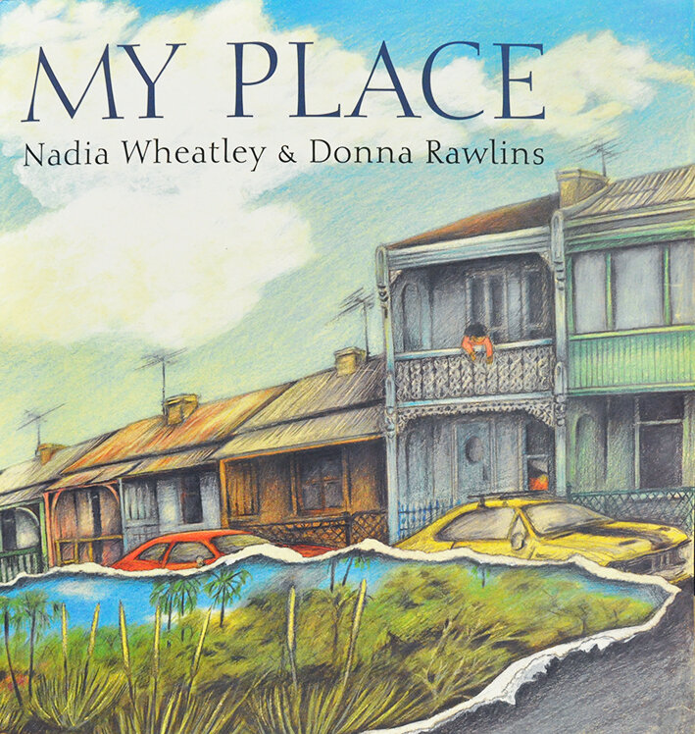
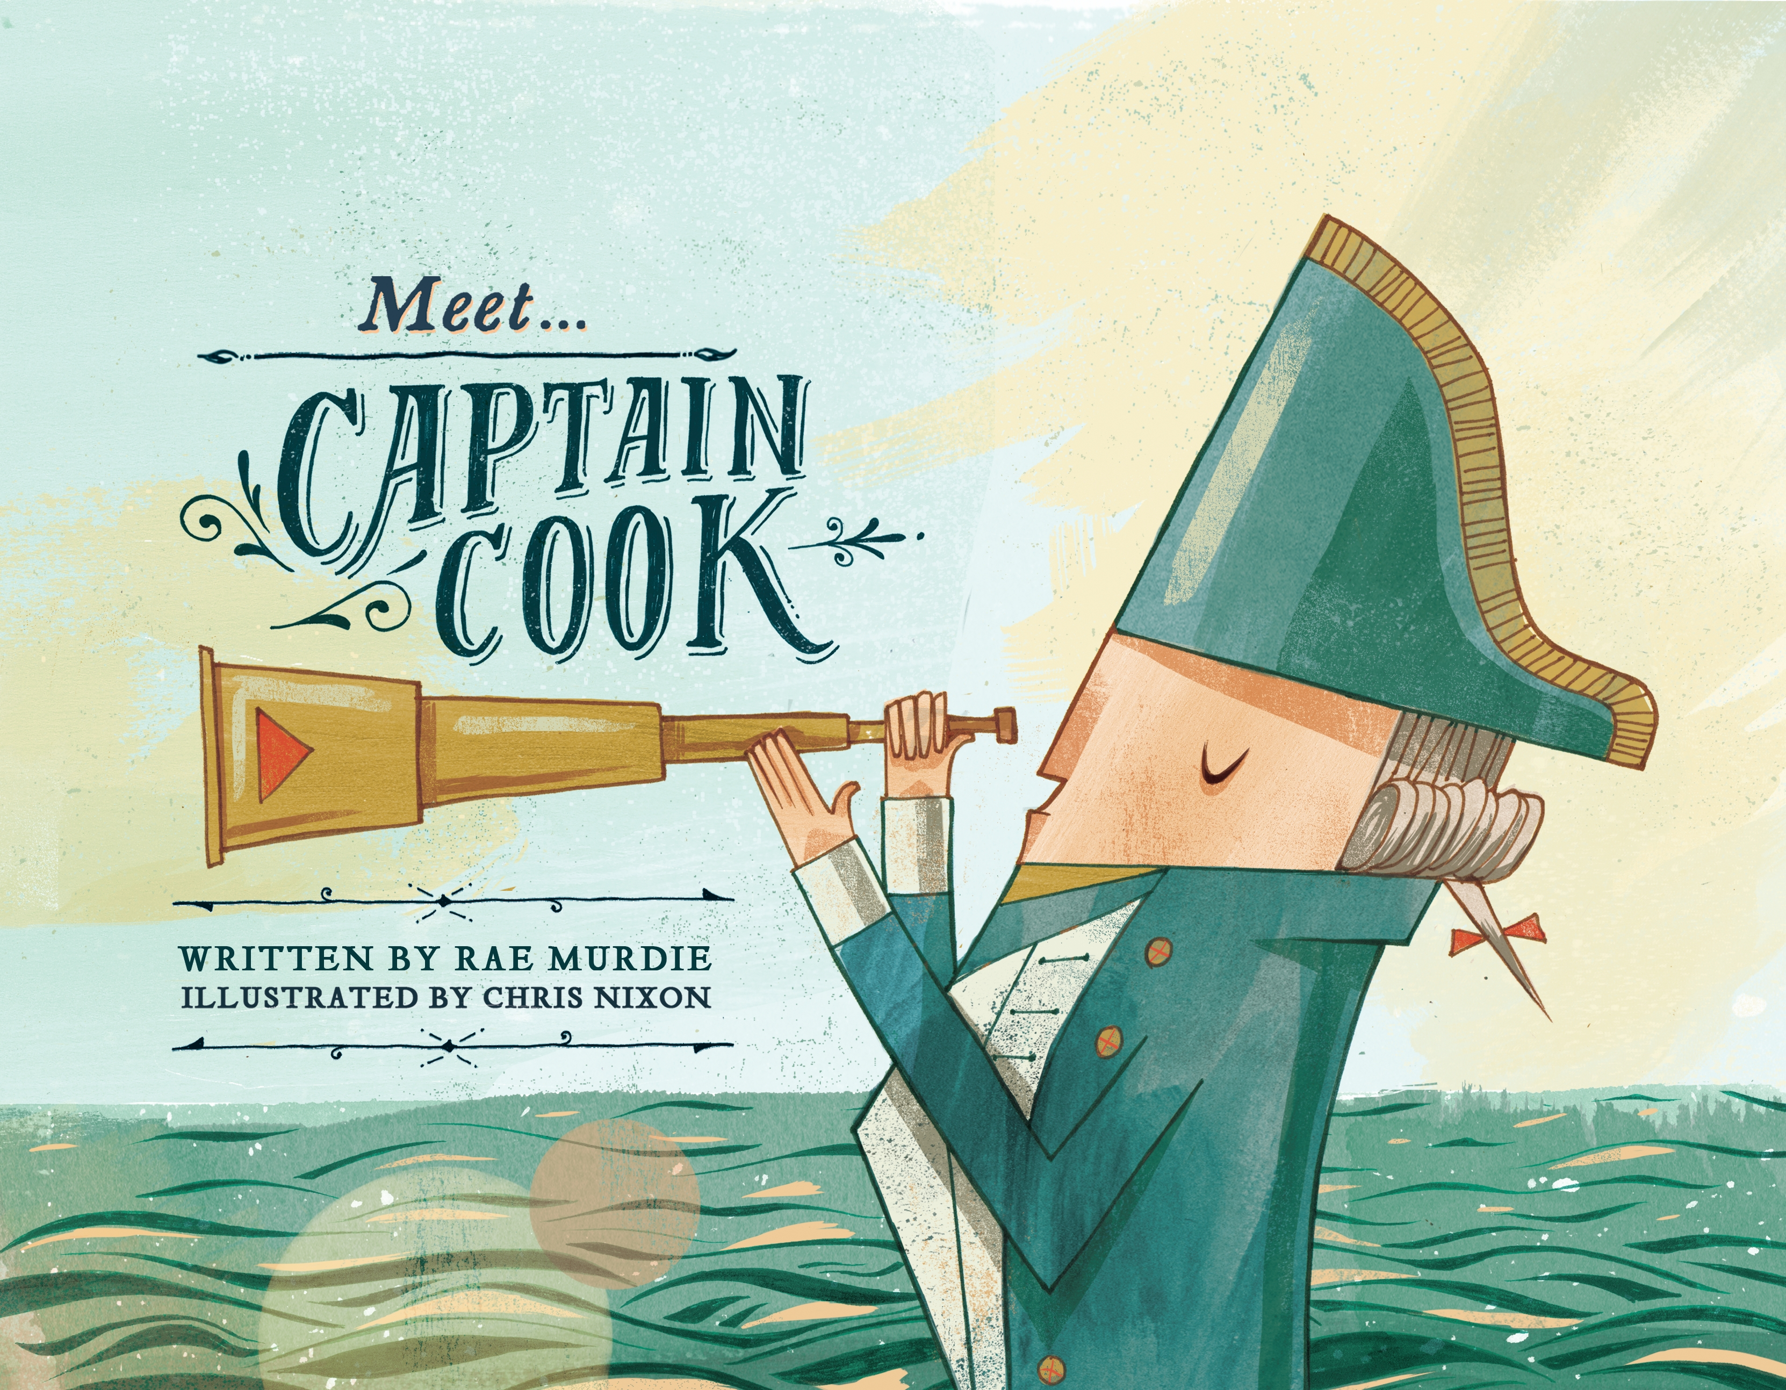
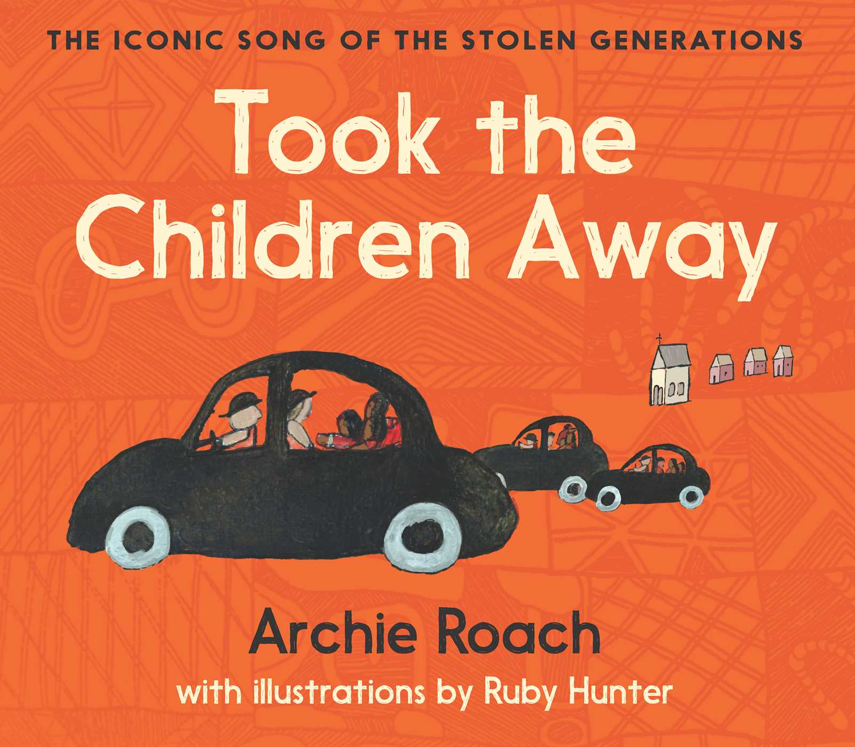
Activity 1: Interview and picture book analysis
Notes:
We are going to watch interviews with Stolen Generations survivors and write responses to them. We will also be analysing two picture books with contrasting perspectives on Australian history, society and culture.
Resources
Stolen Generations stories from Western Australia:
Bigali Hanlon (please note: language warning at 10mins).
Josie Boyle.
Alf Taylor.
Video transcript (Appendix 1).
Question sheet (Worksheet 1).
A range of picture books that explore Australian history/society/culture
Picture book comparison worksheet (Worksheet 2).

Slide 8
The Stolen Generations:
What do you know?
Notes:
Encourage students to share what they know about the Stolen Generations. Use the next slide to explain what happened in more detail.

Slide 9
The Stolen Generations
For about a century, thousands of First Nations children were systematically taken from their families, communities and culture, many never to be returned. These children are known as Stolen Generations survivors.
Notes:
More information:
The Stolen Generations refers to a period in Australia’s history where First Nations children were removed from their families through government policies.
This happened from the mid-1800s to the 1970s. In the 1860s, Victoria became the first state to pass laws authorising the removal of First Nations children from their families.
Similar policies were later adopted by other states and territories – and by the federal government when it was established in the 1900s.
For about a century, thousands of children were taken from their families, communities and culture, many never to be returned.
These children are known as Stolen Generations survivors, or Stolen Children. They were taken by the police, from their homes, and on their way to or from school, and placed in more than 480 institutions, adopted or fostered by non-Indigenous people and often subjected to abuse. The children were denied all access to their culture, they were not allowed to speak their language and they were punished if they did.
There are currently more than 33,000 Stolen Generations survivors in Australia. More than one third of all First Nations peoples are their descendants. In Western Australia, more than half of the population have Stolen Generation links.

Slide 10
Terminology
In pairs, look at the words below and discuss what they mean. If you aren't sure of any write them down to discuss with the class.
Self-determination
Empowered
Consent
Consult
Exploration
Discovery
Colonisation
Settlement
Representation
Diversity
Respect
Cultural safety
Invasion
Resistance
Genocide
Massacre
Perspective
Power
Marginalised
Silenced
Notes:
Define any words as needed for your class.

Slide 11
Cultural Safety
How does a safe classroom look to you?
How does it feel?
How can we be culturally safe?
Notes:
You may have already established this as a class, if so, use this time to reiterate the class rules.
Begin a discussion about cultural safety with the class. Ask them to answer the questions in a 'think/pair/share' activity, or address them as a group.
Use the final question to lead in to the next slide.

Slide 12
Cultural Safety
Open mindedness
Respect
Honest communication
Being mindful of privilege
Notes:
A culturally safe classroom environment relies on open-mindedness, respect and honest communication.
For a discussion to be culturally safe, participants should be mindful of their privilege, whether it be gender, race, sexuality, social class, education, physical ability or mental health etc.
Image credit: Sketchify from Canva

Slide 13
Stolen Generations Survivor: Bigali Hanlon
Notes:
Video link: https://www.youtube.com/watch?v=68kyA5zaRkM
Language warning at 10 minutes
Ensure students have access to the transcripts of the videos (Appendix 1)

Slide 14
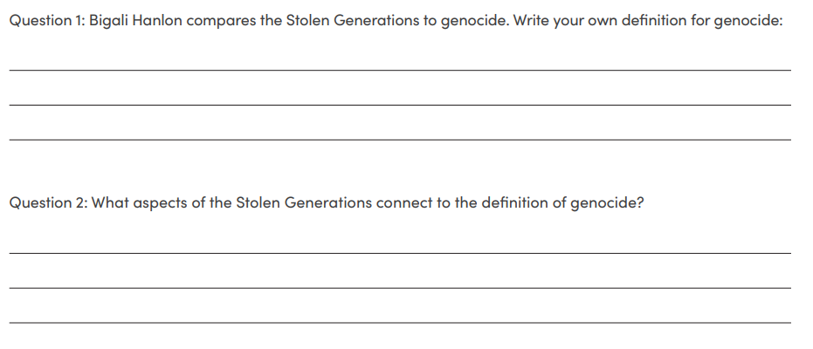
Stolen Generations Survivor: Bigali Hanlon
Answer questions 1 and 2 on the worksheet
Notes:
Ensure students have access to the transcripts of the videos (Appendix 1)
Students may answer the questions individually, in pairs or in groups before discussing the answers with the room

Slide 15
Stolen Generations Survivor: Josie Boyle
Notes:
Video link: https://www.youtube.com/watch?v=I58RXhDkXoM
Ensure students have access to the transcripts of the videos (Appendix 1)

Slide 16
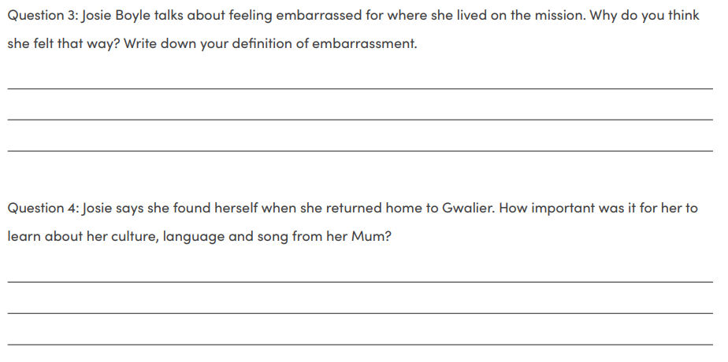
Stolen Generations Survivor: Josie Boyle
Answer questions 3 and 4 on the worksheet
Notes:
Ensure students have access to the transcripts of the videos (Appendix 1)
Students may answer the questions individually, in pairs or in groups before discussing the answers with the room

Slide 17
Stolen Generations Survivor: Alf Taylor
Notes:
Video link: https://www.youtube.com/watch?v=qUE2r429Sv4
Ensure students have access to the transcripts of the videos (Appendix 1)

Slide 18
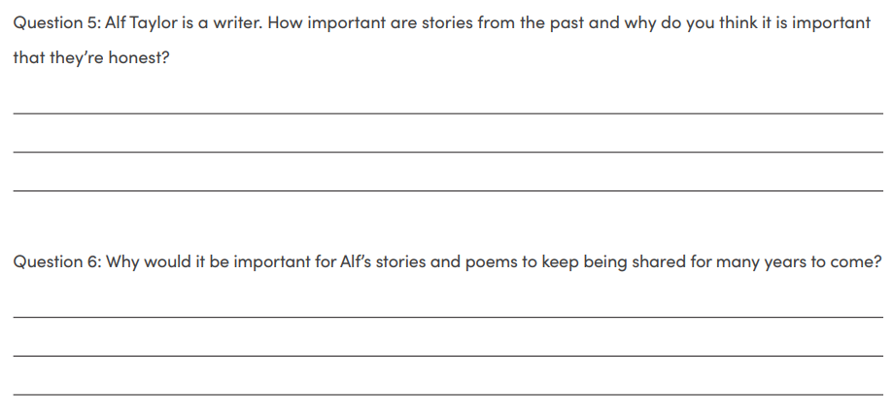
Stolen Generations Survivor: Alf Taylor
Answer questions 5 and 6 on the worksheet
Notes:
Ensure students have access to the transcripts of the videos (Appendix 1)
Students may answer the questions individually, in pairs or in groups before discussing the answers with the room

Slide 19
Picture book analysis
Split into groups of 4-5
Each group will get two picture books
Compare the two books and complete the worksheet to identify and analyse the different perspectives in each text.
You will each present your books and discuss whether the book is a valuable resource in a culturally safe classroom
Notes:
Change group size depending on numbers and book availability.
Students receive a copy of Worksheet 2: Picture book comparison and analysis – year 7

Slide 20
Picture book analysis
Discussion
Notes:
Add images of the books you have in your library for each of the groups so students can point to the board when discussing their decisions

Slide 21
Activity 2:
Diary Entry Writing
Notes:
We'll be writing a diary entry from the perspective of a child whose friend was removed, using the knowledge and understanding we gained in activity 1.
Resources
Diary entry examples, such as:
Hiding by David Simmons, in Remembered by Heart by Sally Morgan.
Ann Curthoys’ Diaries.
The Stolen Generation: motherhood in black and white.
Cook’s Journal – Diary Entries.
Indigenous Anzacs – letters home from Aboriginal soldiers.
Diary entry checklist (Worksheet 3).

Slide 22
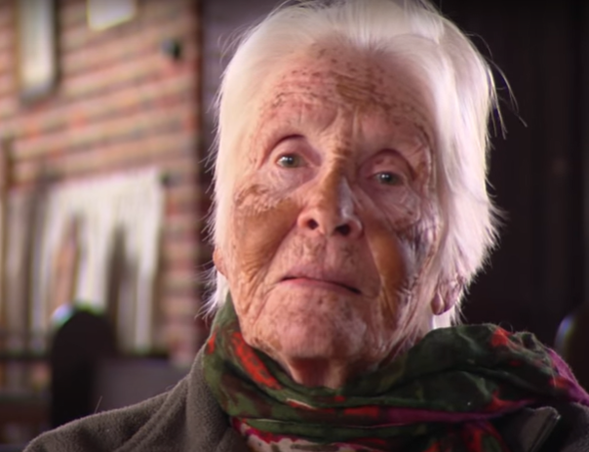
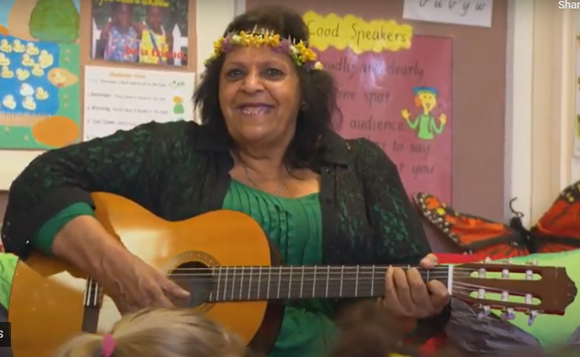
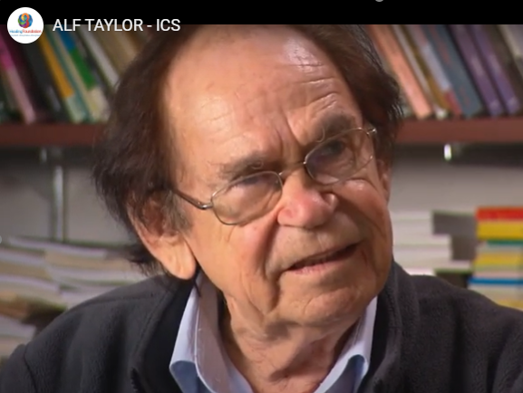
Recap
What makes a culturally safe classroom?
Notes:
Facilitate short whole class discussion on Activity 1, taking stock of student knowledge and understanding of Stolen Generations, perspectives and cultural safety.

Slide 23
Cultural Safety
Open mindedness
Respect
Honest communication
Being mindful of privilege
Notes:
Recap cultural safety:
A culturally safe classroom environment relies on open-mindedness, respect and honest communication.
For a discussion to be culturally safe, participants should be mindful of their privilege, whether it be gender, race, sexuality, social class, education, physical ability or mental health etc.
Image credit: Sketchify from Canva

Slide 24
Diary Entry
Think/Pair/Share: What are some language features of a diary entry?​
First person
Past tense
Sharing observations, thoughts and feelings
Date
Introduction
Emotive language
Detail
Descriptions
Events and entries are in chronological order
Sharing a point of view
Notes:
If students need examples to start them off, you might begin to show a few items on the list before the think/pair/share activity

Slide 25
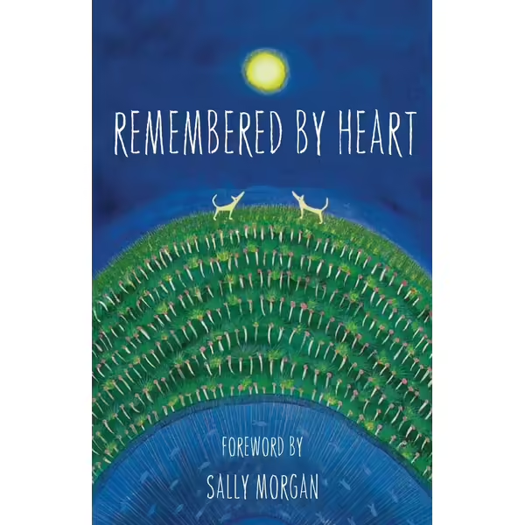
Diary Entry
Hiding by David Simmons
Notes:
Read Hiding by David Simmons as a class.
Guide students to consider experiences and perspectives of children who were friends with Stolen Generations survivors before they were removed from their families.

Slide 26
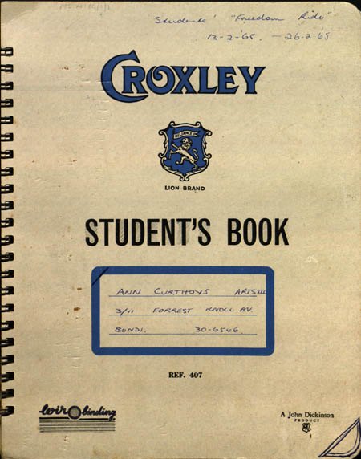
Diary Entry Examples
In small groups (3-4) you will analyse an example of a diary entry
Each group will share with the class:
Whose perspective is this example from?
Which language features of a diary entry can you identify in your example?
Ann Curthoys' Diary
Notes:
Hand out diary entry examples, have students analyse one diary entry in small groups. Remind students of the importance of understanding perspectives when reading these diaries.
Facilitate whole class discussion about perspectives and language conventions present in diary entry examples.
Ann Curthoys' diary: https://aiatsis.gov.au/collection/featured-collections/ann-curthoys-diaries
The Stolen Generation: motherhood in black and white: http://www.auswhn.org.au/blog/stolen-generation-motherhood-black-white/
Cook's Journal: https://webarchive.nla.gov.au/awa/20110403094436/http://southseas.nla.gov.au/journals/cook/17700429.html
Indigenous Anzacs – letters home from Aboriginal soldiers: https://www.abc.net.au/news/2017-04-24/revealing-letters-home-from-aboriginal-diggers-sent-during-wwi/8466938

Slide 27
Diary Entry – your turn!
Step 1: Planning
You will be writing from the perspective of a child whose friend was removed from their family. You may want to focus on one of these situations:
Going to visit their friend only to find out they are no longer living with their family
Overhearing their own parents discussing the removal of First Nations children
Turning up to school and finding out your friend isn't coming back
Notes:
Guide students through the steps to creating their diary entry

Slide 28
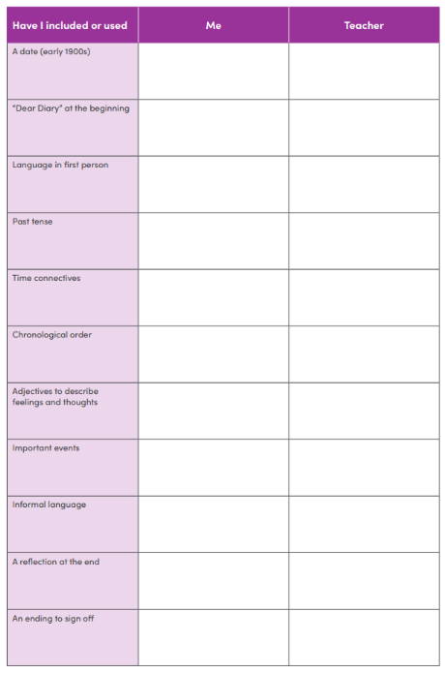
Diary Entry – your turn!
Step 2: Checklist
As you plan your diary entry, use this checklist to make sure you are including all of the important elements of a diary entry
Notes:
Guide students through the steps to creating their diary entry

Slide 29
Diary Entry – your turn!
Step 3: Writing
Refer to your notes:
Language features of a diary entry
Remember to recount the event you've chosen
Checklist
Notes:
Guide students through the steps to creating their diary entry

Slide 30
Diary Entry – your turn!
Step 4: Peer review
Swap your diary entry with a classmate and give each other feedback on:
Content – have they explained the event clearly
Language features – have they written a diary entry?
Pay particular attention to the emotive language they've used (how it made you feel) and the descriptive language (how well they described events, people, feelings, etc.)
Notes:
Guide students through the steps to creating their diary entry

Slide 31
Diary Entry – your turn!
Step 5: Edit & Submit
Use the notes from your classmate to edit your diary entry.
Notes:
Instruct students to submit to you when the diary entry is complete.
End the class with a debrief about any feelings that may have come up during the lesson and remind them about in-school support systems.

Slide 32
Conclusion
Notes:
Select three or four students to read out their diary entries to the class. Peers provide feedback on emotive and descriptive language used to represent perspective.

Slide 33
Activity 3:
Response to the Story of The Healing Foundation
Notes:
Working in pairs, you are going to produce an advertisement for The Story of The Healing Foundation video.
Resources
The Story of The Healing Foundation.
Video transcript (Appendix 2).
Question sheet (Worksheet 4).
Printed images from The Story of The Healing Foundation video (see Appendix 3).
A3 cardboard, coloured paper, markers, pencils, scissors, glue.

Slide 34
Terminology
Audio-visual
Text
Informative
Feature
Aesthetic
Design
Stylistic
Animation
Social
Individual
Community
Nation
Purpose
Audience
Structure
Impact
Notes:
Define any words as needed for your class.
This slide is to give students context for what they should be focusing on when watching the video

Slide 35
Video: The Story of The Healing Foundation
Notes:
Link: https://www.youtube.com/watch?v=zDN7R6qRpUg

Slide 36
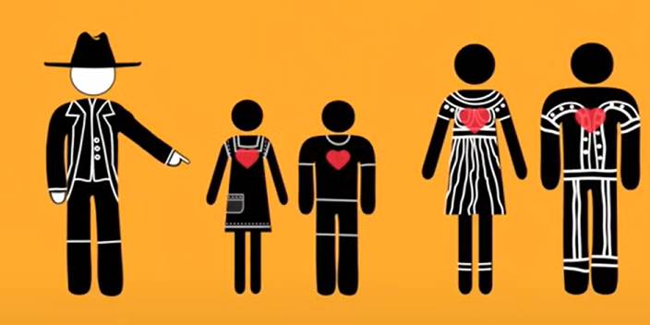
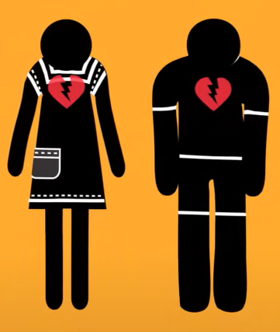
Video: The Story of The Healing Foundation
After watching the video, complete the worksheet on your own
Discuss answers as a class
In groups of 2-3 highlight sections of the transcript that have the strongest impact on the audience
Use your answers to the worksheet as a guide
Notes:
For the first activity: Distribute Worksheet 4: Question sheet – Year 7
Once students have completed – discuss answers and themes with the class
Distribute Transcript for the third activity

Slide 37
Making a poster for
The Story of The Healing Foundation
It's time to get creative!
In groups of 2-3 make a poster encouraging other people at school to watch The Story of The Healing Foundation. You might include...
Quotes:
"Aboriginal and Torres Strait Islander people building communities and healing the trauma with the support of a nation will help to close this gap and preserve and celebrate our culture and our people"
Persuasive paragraph:
We as a school community must all do what we can to close the gap and support the healing of Aboriginal and Torres Strait Islander people!
Visual inspiration:

Slide 38
Conclusion
Notes:
Tell students where their posters will be displayed when they're finished. Allow students time in this lesson or next lesson to look at each other's posters

Slide 39
Activity 4:
Letter to the Minister for Education
Notes:
Using everything we've learnt, we will be writing persuasive letters to the Minister for Education, calling for The Healing Foundation's Stolen Generations Resource Kit for Teachers and Students to be compulsory in all schools.
Resources
Video: What is History for?
Persuasive letter writing infographic.
Persuasive letter writing examples, such as:
Yirrkala Bark Petitions.
The huge debt that we owe to Aborigines.
Social Justice Report – National Apology.
Open letter to the Minister for Education.

Slide 40
Video: What is History For?
Notes:
Link: https://www.youtube.com/watch?v=hLE-5ElGlPM

Slide 41
What is included in Australia's history?
Notes:
Link: https://www.youtube.com/watch?v=hLE-5ElGlPM
Facilitate whole class discussion about the importance of learning about all aspects of Australia’s history in the classroom. Students consider how education can shape perspectives of history, society and culture.

Slide 42
Notes:
RECAP:
Ask students what they have learnt so far in these activities. Use images to prompt learning. Focus on perspective and starting to build answers to the questions on the next slide:
What are social and cultural issues in Australia today?
How can we use education about the Stolen Generations to bring awareness to these issues?

Slide 43
What are social and cultural issues in Australia today?
How can we use education about the Stolen Generations to bring awareness to these issues?
Notes:
Introduce questions one at a time, using a mind map or a similar shared resource to add students ideas and thoughts as the discussion takes place.

Slide 44
Persuasive Writing
The huge debt that we owe to Aborigines'*
Open mindedness
Before we begin:
Appropriate terminology
Remember cultural safety!
Respect
Honest communication
Being mindful of privilege
Notes:
Link to article: https://www.theage.com.au/national/victoria/the-huge-debt-that-we-owe-to-aborigines-20150311-141283.html
Before analysing the persuasive text, facilitate a whole class discussion about the use of appropriate terms. This can be linked to students’ prior learning of cultural safety.
Recognise that we have the privilege to gain education and awareness about which terms are appropriate to use (Aboriginal and Torres Strait Islander) and which are not (Aborigine, Native, Half-Caste etc.).
Acknowledge that the use of inappropriate terms does not necessarily equate to discrimination or intentional offence, but that age, socioeconomic status and geographic location all contribute to an individual’s awareness of correct terms.
As a class, read through the text and discuss persuasive language features (begin to introduce the language features of persuasive writing)

Slide 45
Persuasive Writing
Features of a persuasive letter:
Hook – get the reader interested from the very beginning
Introduction – explain to the reader why you're writing the letter
Arguments – backed up by evidence
Emotive language – help the reader feel your passion/concern
Conclusion – reiterate your main point and summarise why it's important
Notes:
Include any features of persuasive writing that your class is already familiar with such as metaphor, hyperbole, statistics, repetition, alliteration, inclusive & exclusive language, and rhetorical questions
Distribute examples of persuasive letters and have students work in small groups to identify the features on the slide.
Links:
Yirrkala Bark Petitions: https://www.sbs.com.au/nitv/article/the-yirrkala-bark-petitions/44khztxiy
Social Justice Report 1998 Letter to the Editor: https://humanrights.gov.au/our-work/social-justice-report-1998-appendix-1-letters-editor
The huge debt that we owe to Aborigines: https://www.theage.com.au/national/victoria/the-huge-debt-that-we-owe-to-aborigines-20150311-141283.html
Open letter to Minister for Education: https://www.aare.edu.au/blog/?p=472

Slide 46
Persuasive Writing: Letter to the Minister for Education
You will now write a persuasive letter to the Minister for Education recommending that The Stolen Generation Resource Kit be compulsory in all schools.
Make sure you include the features of a persuasive letter!
A hook – get the reader interested from the very beginning
An introduction – explain to the reader why you're writing the letter
Arguments – backed up by evidence
Emotive language – help the reader feel your passion/concern
Conclusion – reiterate your main point and summarise why it's important
Notes:
You may choose to include the name of the current Minister in your state or in Federal Government.
Once students have finished, get them to pair up and give each other feedback before writing their final copy.
You may finish this activity by reading out a few of the letters, or encouraging students to post them to the Minister for Education.

Slide 47
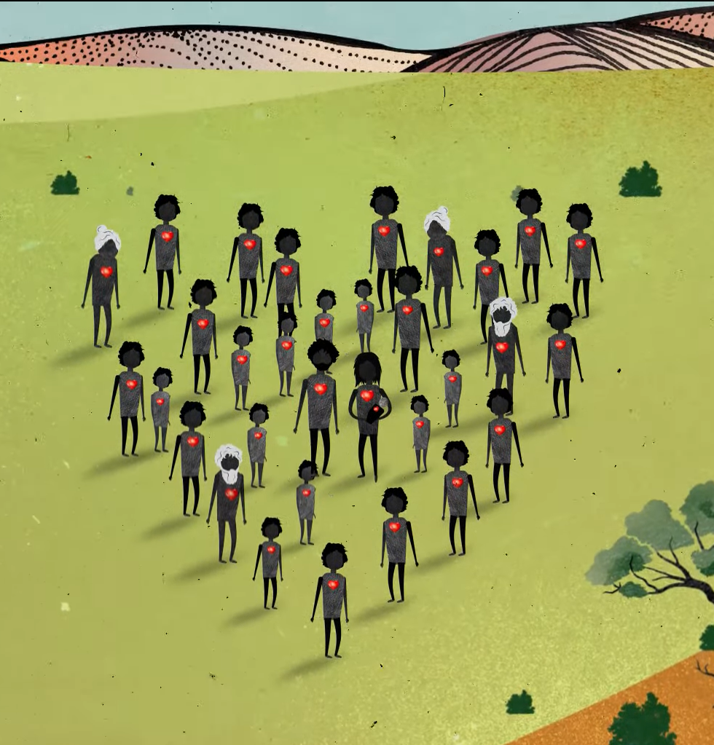
Contact The Healing Foundation
@HealingFoundation
@healingourway
@healingourway
www.healingfoundation.org.au
Healing Foundation
Notes:
Consider:
Sharing your outcomes and experience with The Healing Foundation at resources@healingfoundation.org.au
Sharing the resource and how you used it amongst your networks.
Sharing your students’ learning journey and tag The Healing Foundation on Instagram @healingourway and on Facebook as ‘Healing Foundation’.

