Slide 1
Year 1

Slide 2
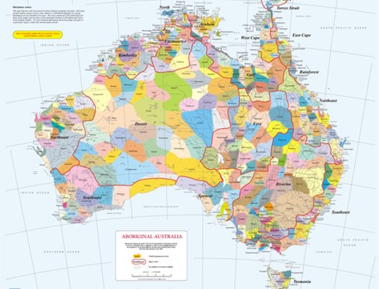
Acknowledgement
[Name of school/class] acknowledges Country, Custodians and Community of the lands on which we are on today [insert name of land/ peoples].
We also pay our respects to Elders and to Stolen Generations survivors, of the Dreaming and of the here and now.
We recognise the ongoing nature of trauma experiences for First Nations peoples and commit each day to survivor-led intergenerational healing.
Notes:
Update this slide with the name of your school/ class and the name of the land/s on which you're presenting the lesson on.
You may choose to make the wording of this acknowledgement more specific to your land/school/experiences. The acknowledgement isn't a script that we have to follow, you may even introduce the unit by working with students to write an acknowledgement for your class.
Image credit: https://ipaustralia.libguides.com/c.php?g=451400&p=3082380

Slide 3
Aboriginal and Torres Strait Islander students and teachers should be aware that these resources may contain the names, images, and voices of deceased persons.
Notes:
Important to remind students to speak up if they are feeling discomfort, and any safety and wellbeing measures your school has in place.

Slide 4
Care and safety
Notes:
Important to remind students to speak up if they are feeling discomfort, and any safety and wellbeing measures your school has in place.
This is also a good place to ask the cultural safety questions from the educator's guide so you can co-construct a culturally safe space with your students.

Slide 5
Overview: this week’s activities
ACTIVITY 1: LITERATURE INTRODUCTION (20–30 MINUTES)
Teacher leads students in a guided reading session of an Aboriginal and Torres Strait Islander story. Students create a yarning circle.
ACTIVITY 2: STORYTELLING TRADITION (30–40 MINUTES)
Students explore the oral storytelling tradition in Aboriginal and Torres Strait Islander culture and create their own retelling of a story with freeze frames.
ACTIVITY 3: VIDEO RESPONSE (30–40 MINUTES)
Students view and respond to an animation. Whole class uses images from video to sequence and retell the
story.
ACTIVITY 4: DISPLAY AND REFLECT ON LEARNING (40–60 MINUTES)
Students create a presentation or engage in small group discussion to verbally retell Florence Onus’ story and then share their learning with their school and home community.
Notes:
OPTIONAL SLIDE
Update week to timeframe for these teaching activities in consideration of class schedule and activity time.

Slide 6
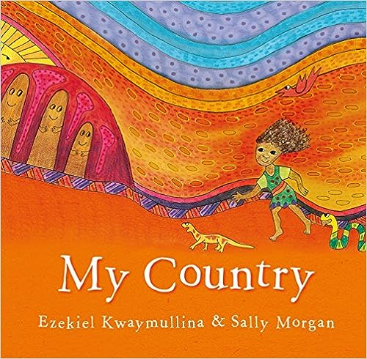
Activity 1: Literature Introduction
Notes:
In this activity, students will be led in a guided reading session of an Aboriginal and Torres Strait Islander story before creating a yarning circle.
Resources
Suggested book for this session: My Country by Ezekiel Kwaymullina and Sally Morgan.
Butchers’ paper and pens.
Equipment to help you create a yarning circle (e.g. logs arranged outside, cushions arranged inside, an object that will act as a power instrument for speaker to hold).
Read information about yarning circles.

Slide 7
Read book: My Country by Ezekiel Kwaymullina & Sally Morgan
Notes:
Read the selected book, stopping to explain or answer questions if necessary.
Once you have finished the book, discuss any key points. You might ask:
What did you like about the story?
What did you learn from the story?
Are there any words in the story that are new to you?
How does the book use illustration to help us feel something in the story?
You may like to take notes on the students' responses and display them on the classroom wall. This activity can be used to activate students’ prior knowledge about First Nations history and gauge any misinformation students may have about Aboriginal and Torres Strait Islander cultures or history.

Slide 8
Yarning Circles
Notes:
Encourage students to share what they know about Yarning Circles. Use the next slide to explain what happened in more detail.

Slide 9
Yarning Circles
respectful relationships
group learning
shared knowledge
Notes:
The use of Yarning Circles is an important process within Aboriginal and Torres Strait Islander cultures. This process has been used by Indigenous people from around the world for centuries to build respectful relationships, learn from a collective group and to preserve and pass on cultural knowledge.

Slide 10
Yarning Circle
Notes:
As a group pick an appropriate place in the classroom that will be set up as a permanent yarning circle.
Create the yarning circle using cushions/blankets if inside, or logs/mats/other appropriate material if outside.
Practice using the yarning circle in this session by having students talk about the book they just read. If children need prompting, they can give one word to describe their thoughts and reactions to the book.

Slide 11
Activity 2:
Storytelling tradition
Notes:
In this activity students explore the oral storytelling tradition in Aboriginal and Torres Strait Islander culture and create their own retelling of a story with freeze frames.

Slide 12
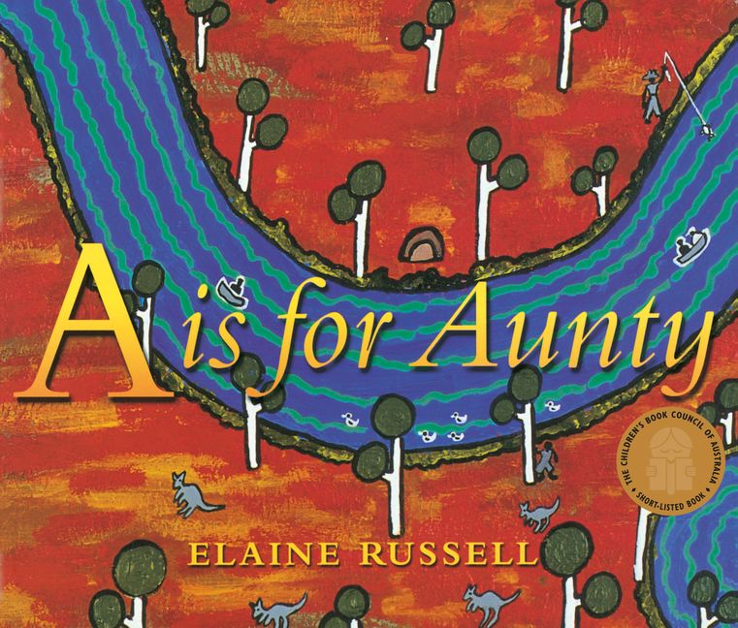
Read book: A is for Aunty by Elaine Russell
Notes:
Read the selected book, stopping to explain or answer questions if necessary.
Once you have finished the book, discuss any key points. Record some thoughts on the whiteboard/ butchers paper.
You might ask:
What did you like about the story?
What did you learn from the story?
Are there any words in the story that are new to you?
Use one word to describe how the book made you feel.
How does the book use illustration to help us feel something in the story?

Slide 13
Storytelling Tradition
Notes:
Ask students to think about stories their parents or family have told them:
Not stories from a book, but stories from the past when your parents or carers were little. Funny stories about things you did when you were a baby, or important stories about significant events like how your parents met or how your family came to live in your home.
Model telling a story from your own past or your family’s history.
Ask students to work with a partner and share their stories with each other. Ask each pair to respond to each other’s stories by telling each other how the story made them feel.
Ask students how they told those stories. Did you need a book or illustrations to tell the story?
Introduce the idea that in Aboriginal and Torres Strait Islander culture, telling stories just using your voice (oral tradition) is very important.
Often in Aboriginal and Torres Strait Islander culture, stories would be told by Elders to educate, to entertain, to warn of danger, to teach about the importance of taking care of country and lots more. Today we are going to listen to a story from the Torres Strait.

Slide 14
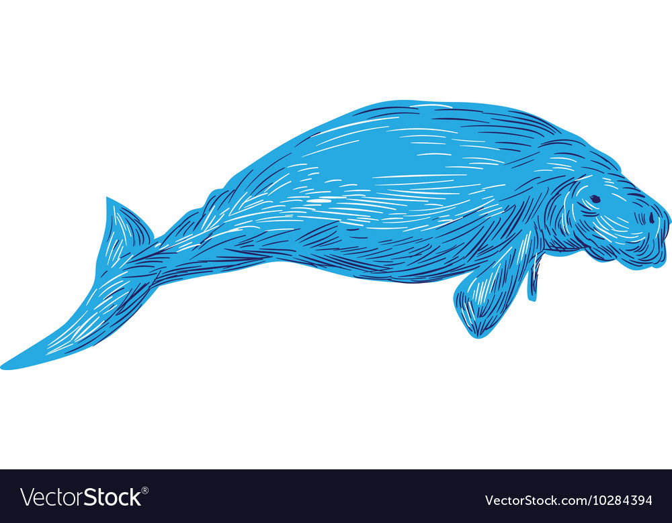
Audio: Gelam—creator of dugong
Notes:
Play the students the audio of the Torres Strait Islander story Gelam—creator of dugong (do not show the video). A small version of the video is in the bottom left corner of this slide.
Image source: https://www.vectorstock.com/royalty-free-vector/dugong-drawing-vector-10284394
Video Link: https://www.youtube.com/watch?v=l0oBFtlDwTs

Slide 15
Audio: Gelam—creator of dugong
1 | 2 | 3 | 4 | 5​
Notes:
Once students have listened to the recording once, discuss the key elements they can remember from the story and use butchers’ paper to write out the sequence of events in the story. Keep it extremely simple with only 4–5 key events in the story.
Put students into 4–5 small groups (depending on class size and how many key events the class listed from the story).
Tell students that in their group they are going to create a ‘photo’ of one part of the story. Assign one event to each group and tell them to think of how they could use their bodies and work as a group to show their part of the story. If students need support, remind them that their ‘photo’ might need scenery (could someone be the waves or the trees? Could more than one person be the dugong?)
Image source: https://www.vectorstock.com/royalty-free-vector/dugong-drawing-vector-10284394

Slide 16
Audio: Gelam—creator of dugong
Notes:
CONCLUSION
Have all students sit as an audience. As you narrate the story, groups get up in order and freeze in their ‘photo’. Audience can discuss and respond.
If you have the resources, film the whole performance to show parents and carers or the school community.
Image source: https://www.vectorstock.com/royalty-free-vector/dugong-drawing-vector-10284394

Slide 17
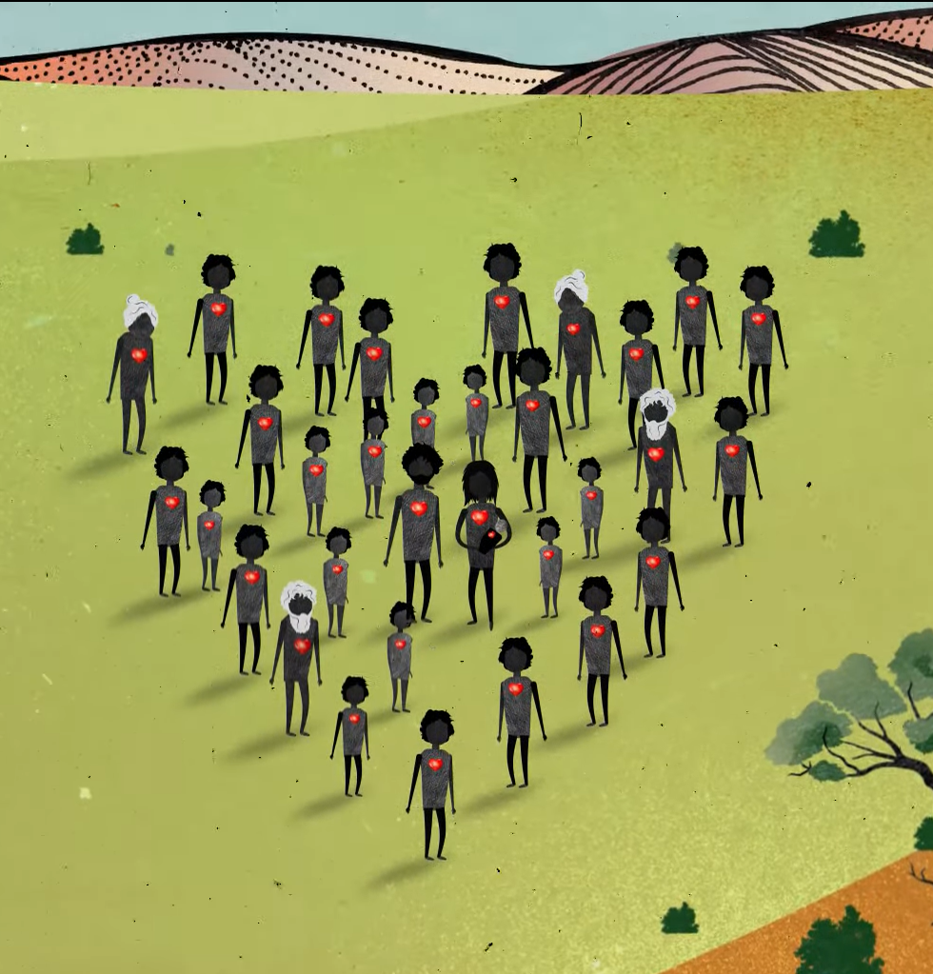
Activity 3:
Video Response
Notes:
Students view and respond to an animation. Whole class uses images from video to sequence and retell the story.
Resources
Suggested book for this session: Sorry Day by Coral Vass.
Intergenerational Trauma animation: https://www.youtube.com/watch?v=vlqx8EYvRbQ
Script for Intergenerational Trauma video
Butchers’ paper for teacher with three columns drawn: ‘I see…I think…I feel…’
A4 colour print outs of animation images (if you choose to do the sequencing activity in small groups, you will need multiple copies of the illustrations—a set for each group).
Butchers’ paper that is used to record retelling during class brainstorm.

Slide 18
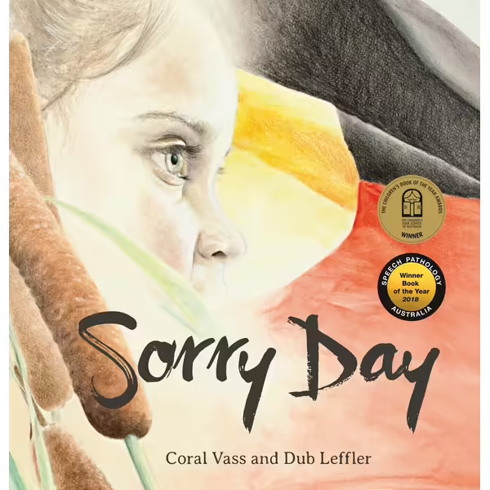
Read book: Sorry Day by Coral Vass and Dub Leffler
Notes:
Read the selected book, stopping to explain or answer questions if necessary.
Once you have finished the book, discuss any key points. Record some thoughts on the whiteboard/ butchers paper.
You might ask:
What did you like about the story?
What did you learn from the story?
Are there any words in the story that are new to you?
Use one word to describe how the book made you feel.
How does the book use illustration to help us feel something in the story?

Slide 19
Notes:
Link: https://www.youtube.com/watch?v=JOQ12Lc2JGY
Remind students of the storytelling tradition discussed in the last lesson.
Introduce the video:
Today, we are going to watch a video that shows the story of the Stolen Generations. Before you were born, the governments in Australia created laws that said that many First Nations children should be taken from their homes and families to live in other places. Taking these children away from their homes and families caused a lot of pain and sadness that still exists today. The children who were taken are called the Stolen Generations. These children have grown up now and have families of their own and lots of them are still healing from their sadness.
Play the animation WITHOUT AUDIO. Read the script as the video plays. Be prepared to answer questions and discuss ideas further.
Animation Link: https://www.youtube.com/watch?v=vlqx8EYvRbQ
Script Link: https://healingfoundation.org.au//app/uploads/2023/10/HF_SGRK_IGT_Animation_Script_Oct2023.pdf

Slide 20
I hear…
I think…
I feel…
Notes:
Ask students to respond to video with ‘I hear… I think… I feel…’ as a class brainstorm. If needed, rewatch the video. Students can discuss in pairs and then share as a class.

Slide 21
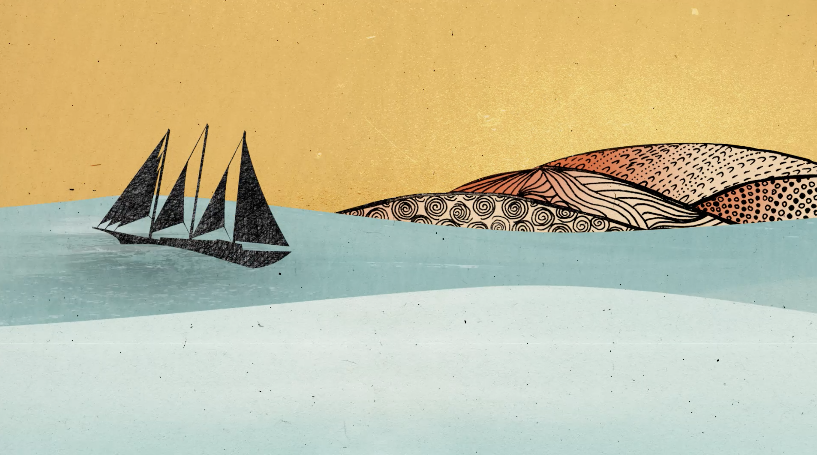
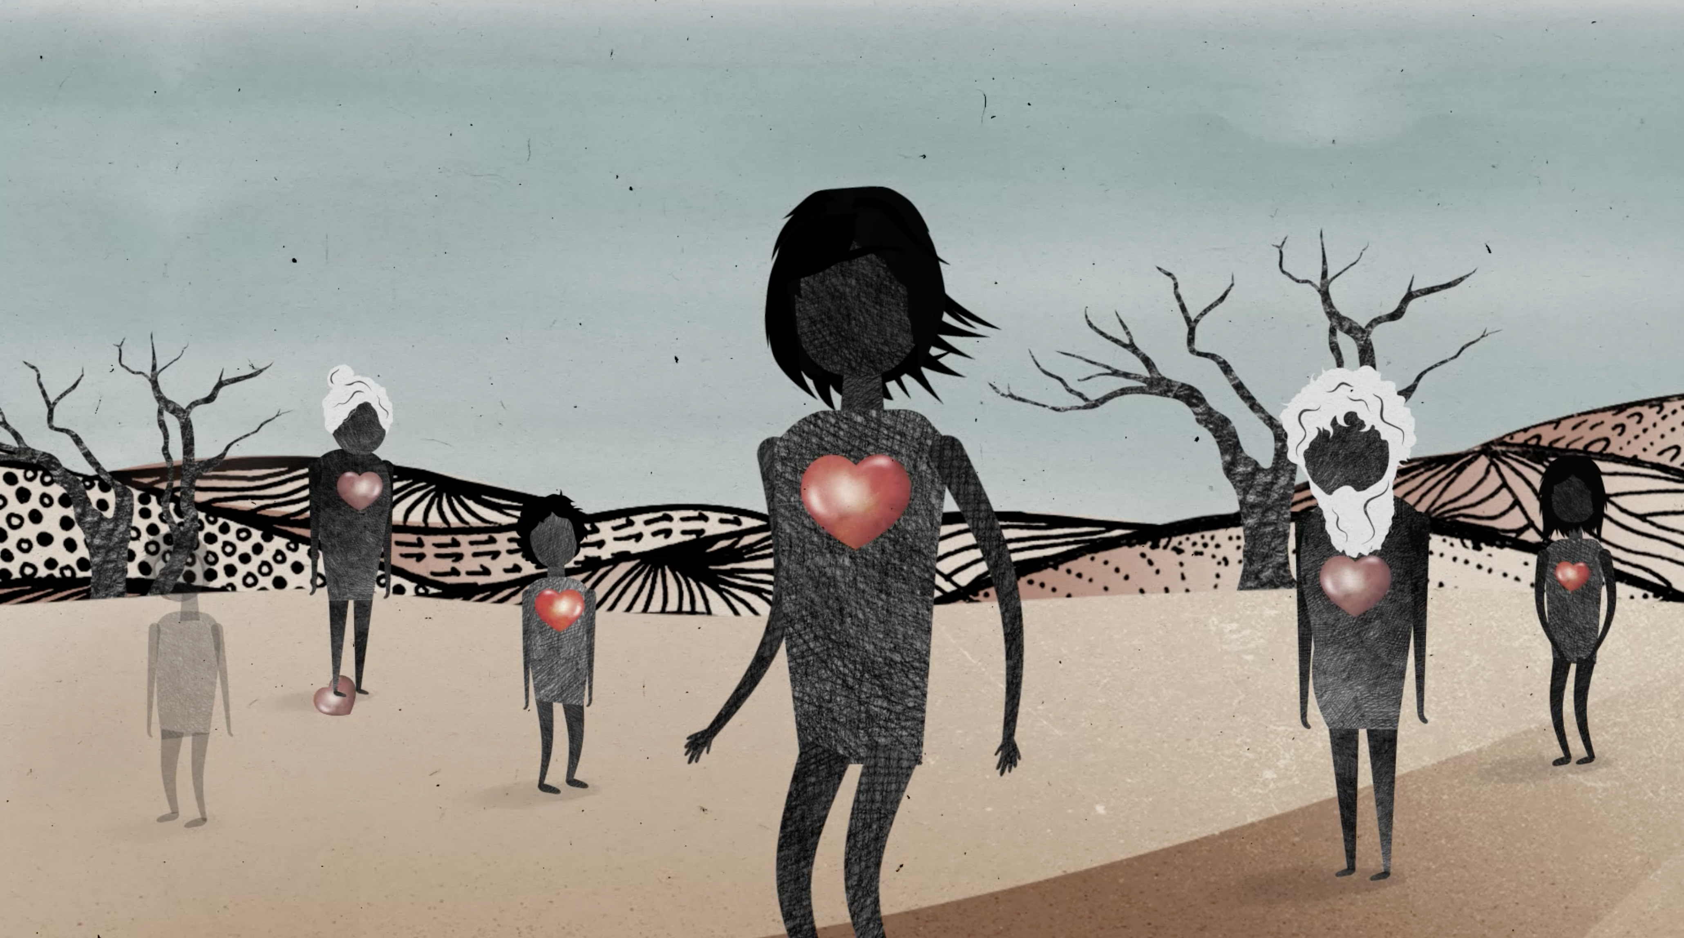
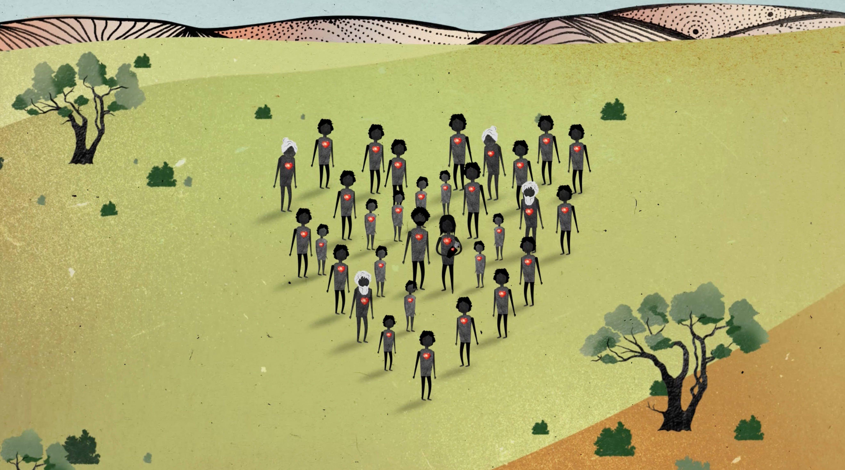
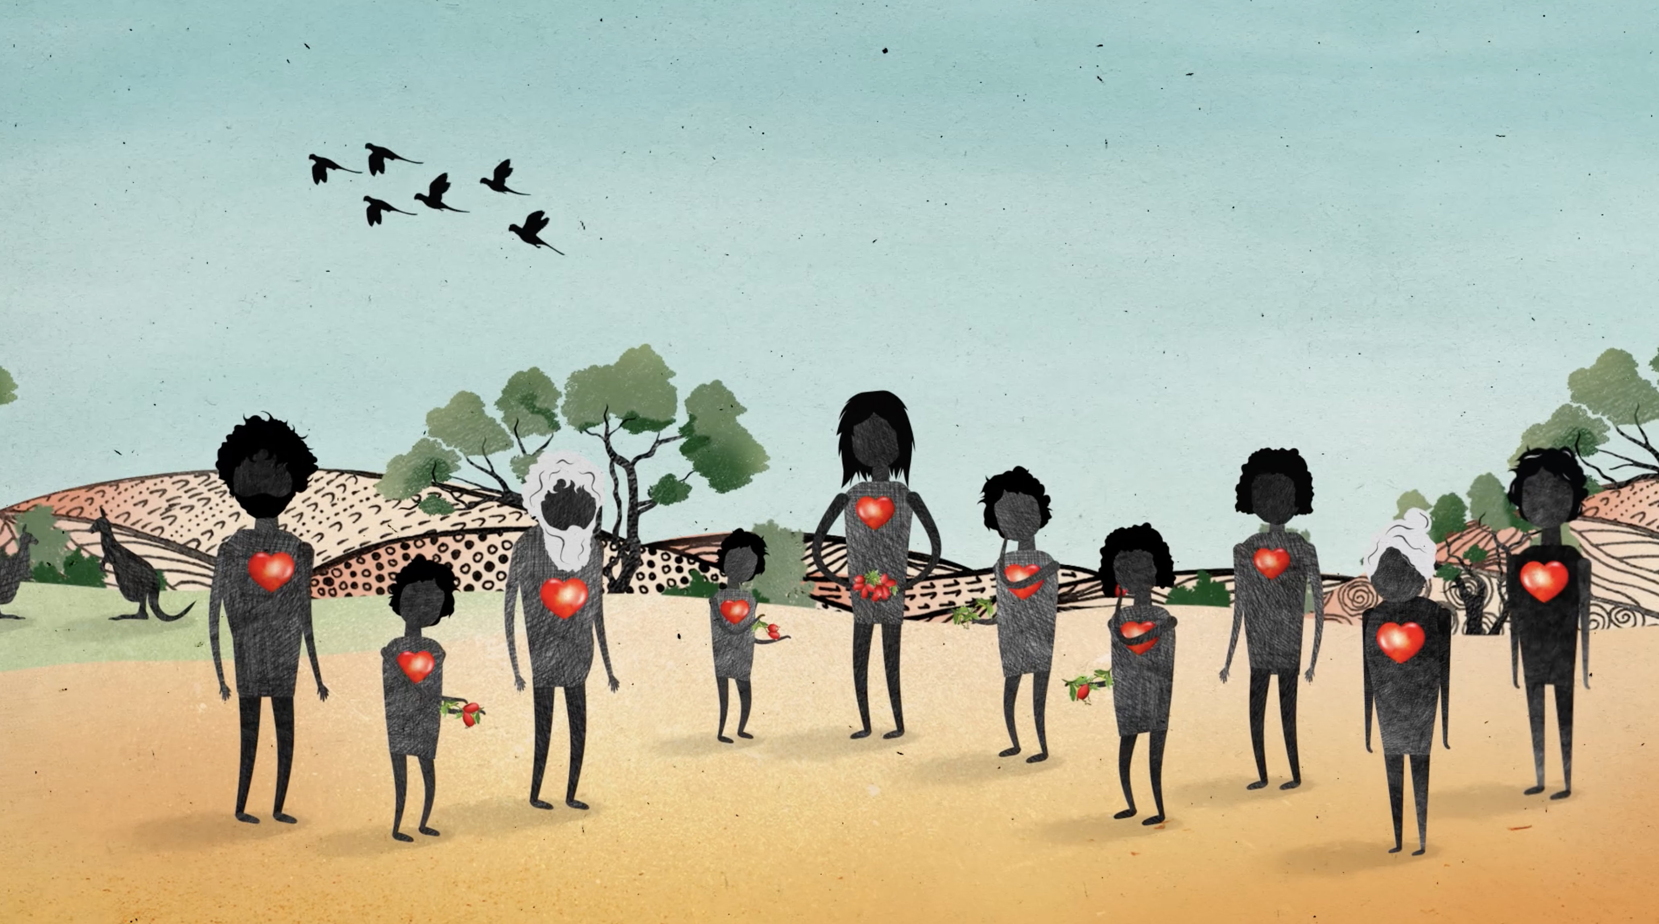
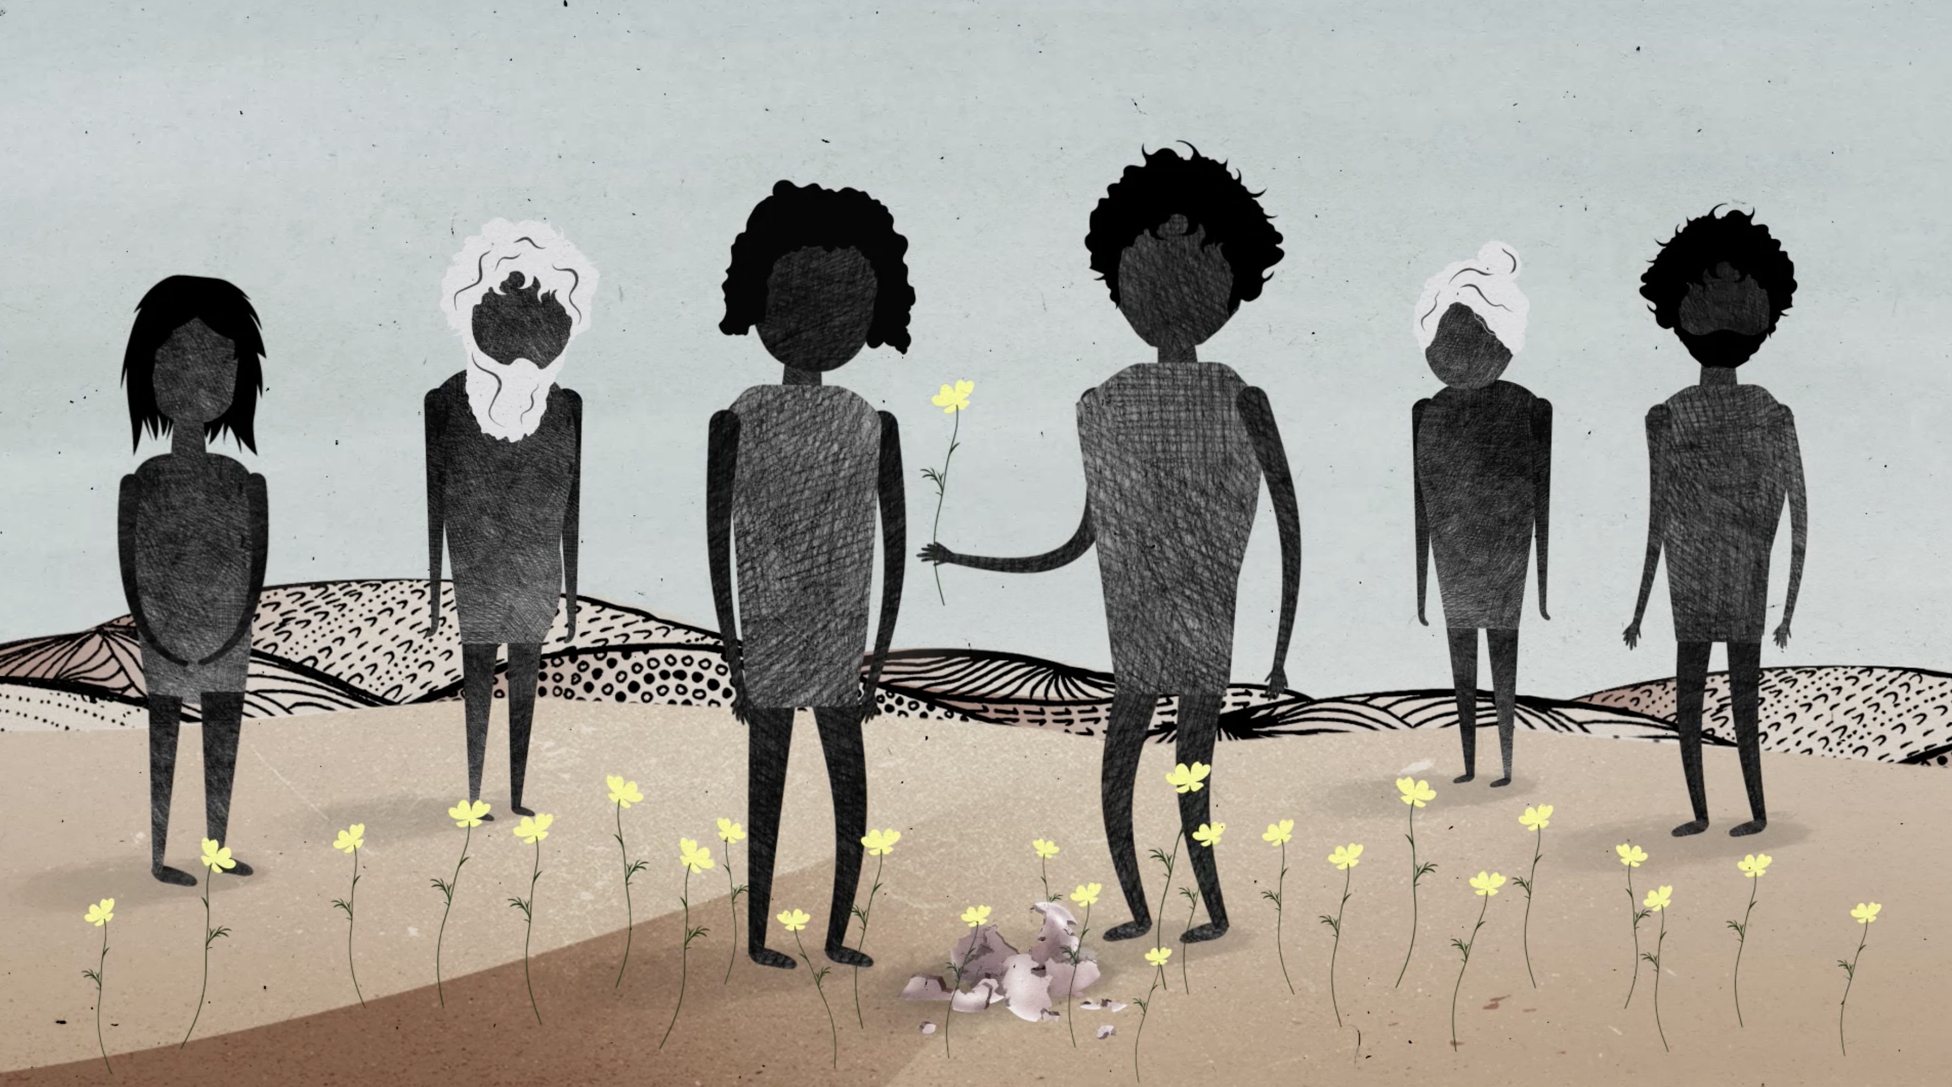
Story Sequencing
Notes:
You may wish to print out copies of these images so students can put them in order in groups. Make sure they are out of order when giving them to students.
Show students images from the animation. Make sure to show them out of order.
As a class, students must sequence the images and retell the story of the Stolen Generations. Using butchers’ paper, record class retelling for display in the classroom and reference for final activity.
Illustrations: https://healingfoundation.org.au//app/uploads/2023/10/HF_SGRK_IGT_Animation_Illustrations_Oct2023.pdf

Slide 22
Yarning Circle
Notes:
Use the yarning circle to allow students to share their feelings and thoughts about the lesson.

Slide 23
Activity 4:
Display and reflect on learning
Notes:
Students reflect on their learning across the previous activities in a yarning circle before completing a small project individually.
Resources
Suggested book for this session: Our Island by The Children of Gununa with Alison Lester and Elizabeth Honey.
Print outs of the Intergenerational Trauma animation.
Art supplies.
Equipment to help you create a yarning circle (e.g. logs arranged outside, cushions arranged inside, an object that will act as a power instrument for speaker to hold).

Slide 24
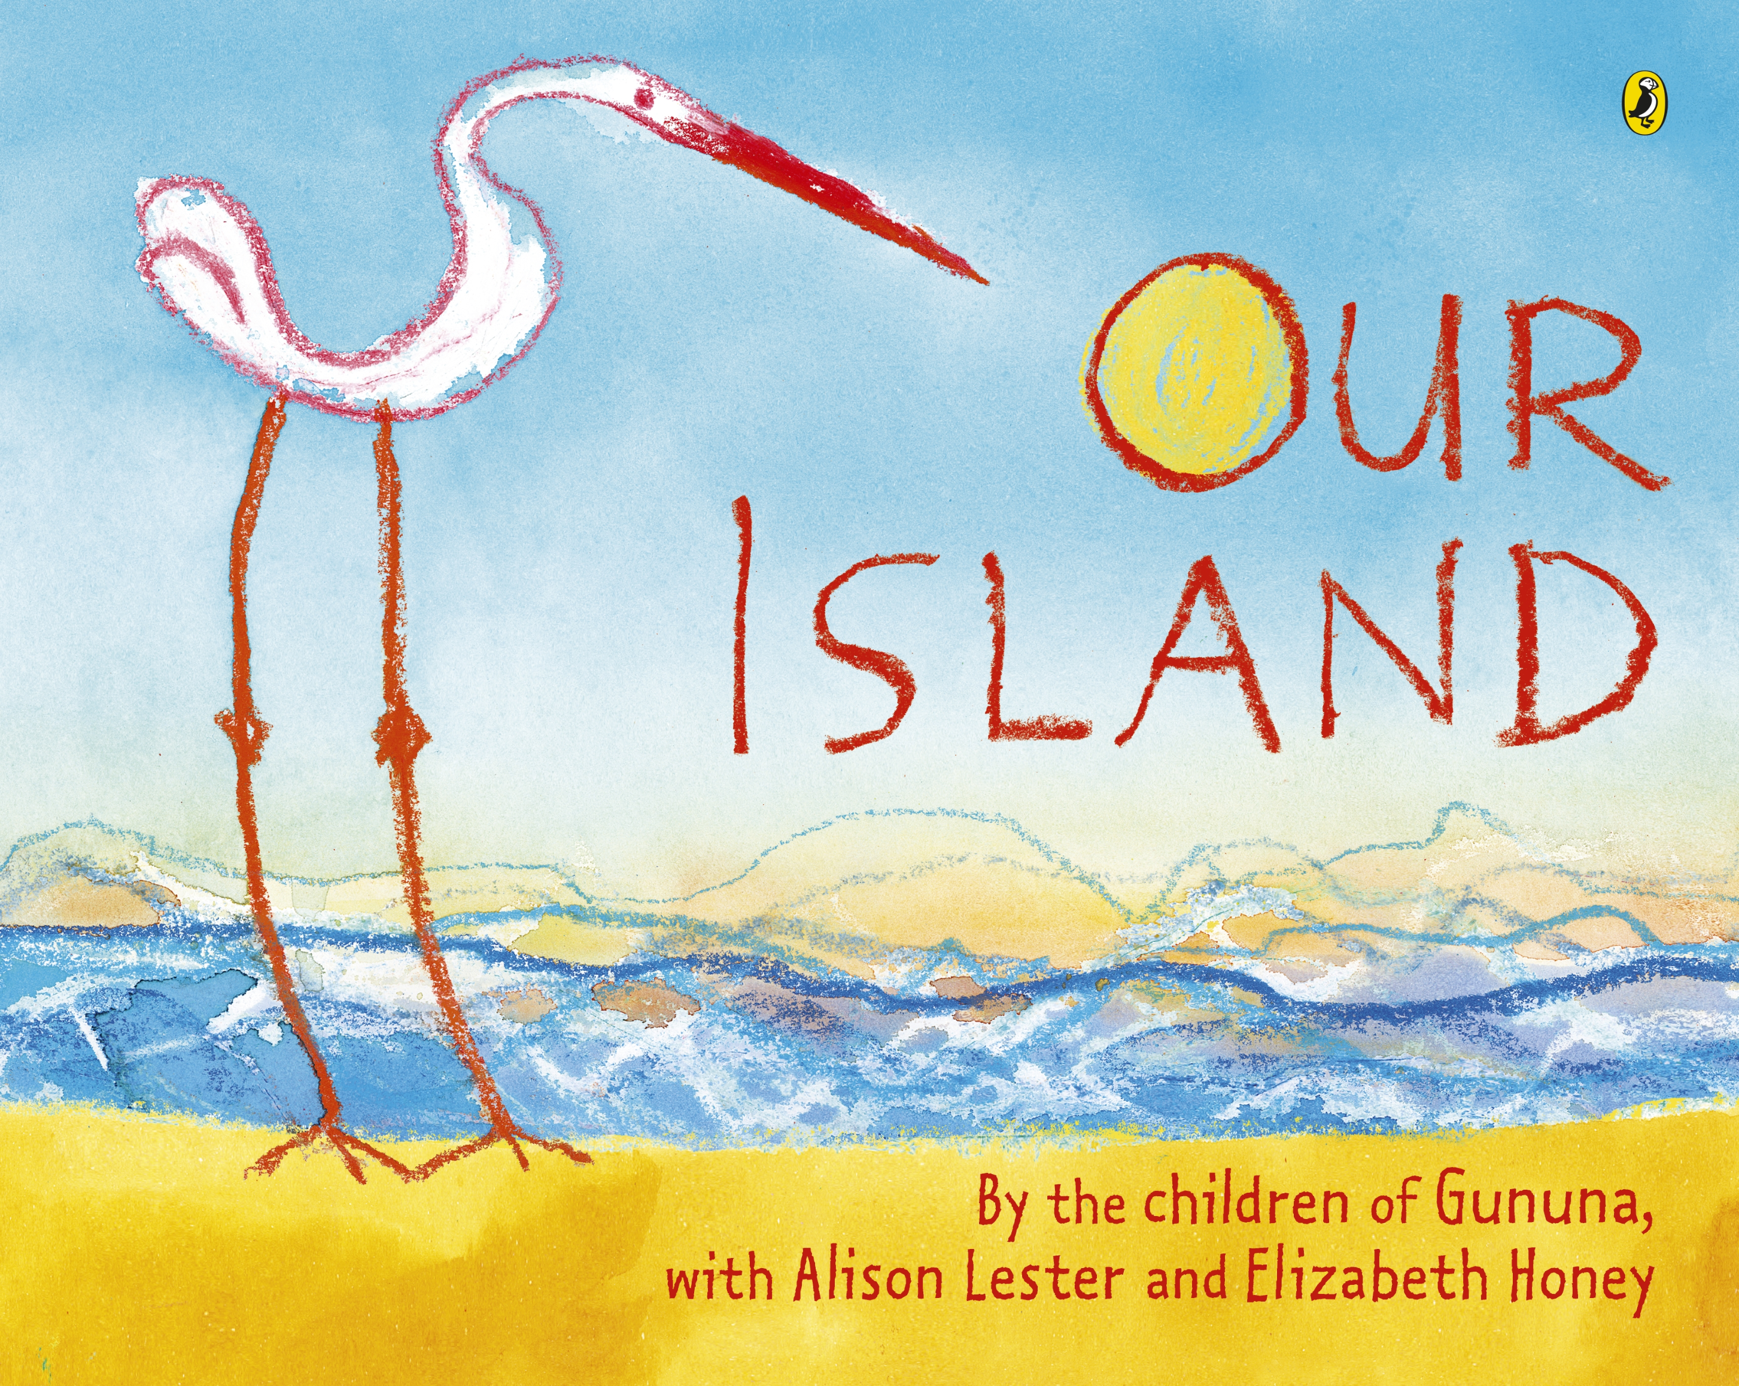
Read book: Our Island by The Children of Gununa with Alison Lester and Elizabeth Honey
Notes:
Read the selected book, stopping to explain or answer questions if necessary.
Once you have finished the book, discuss any key points. Record some thoughts on the whiteboard/ butchers paper.
You might ask:
What did you like about the story?
What did you learn from the story?
Are there any words in the story that are new to you?
Use one word to describe how the book made you feel.
How does the book use illustration to help us feel something in the story?

Slide 25
Yarning Circle
Notes:
Use the yarning circle to allow students to share their thoughts about their learning. They could answer the prompt questions as a class:
What do you think you have learnt about Aboriginal and Torres Strait Islander peoples?
How did you feel when you listened to the story and watched the animation?
What was your favourite story we read this week and why?
Why do you think it is important for us to learn about the Stolen Generations?

Slide 26
I hear…
I think…
I feel…
Notes:
Encourage students to think about what they discussed in the yarning circle, and use this knowledge to make
a piece of art
Students can create something based on anything they learned this week.
Gently discourage students from reproducing First Nations art styles as much as possible.

Slide 27
Yarning Circle
Notes:
Come back to the yarning circle and give students the opportunity to share their creations and encourage them to explain what they’ve made
You may choose to put these on display in the classroom or library

Slide 28
Contact The Healing Foundation
@HealingFoundation
@healingourway
@healingourway
www.healingfoundation.org.au
Healing Foundation
Notes:
Consider:
Sharing your outcomes and experience with The Healing Foundation at resources@healingfoundation.org.au
Sharing the resource and how you used it amongst your networks.
Sharing your students’ learning journey and tag The Healing Foundation on Instagram @healingourway and on Facebook as ‘Healing Foundation’.

